Slide 1
UNIT 3

Slide 2
Considerations with Optical Sources
Physical dimensions to suit the fiber
Narrow radiation pattern (beam width)
Linearity (output light power proportional to driving current)

Slide 3
Considerations with Optical Sources
Ability to be directly modulated by varying driving current
Fast response time (wide band)
Adequate output power into the fiber

Slide 4
Considerations…
Narrow spectral width (or line width)
Stability and efficiency
Driving circuit issues
Reliability and cost

Slide 5
Semiconductor Light Sources
A PN junction (that consists of direct band gap semiconductor materials) acts as the active or recombination region.
When the PN junction is forward biased, electrons and holes recombine either radiatively (emitting photons) or non-radiatively (emitting heat). This is simple LED operation.
In a LASER, the photon is further processed in a resonance cavity to achieve a coherent, highly directional optical beam with narrow linewidth.

Slide 6
LED vs. laser spectral width
Single-frequency laser
(<0.04 nm)
Laser output is many times
higher than LED output; they
would not show on same scale
Standard laser
(1-3 nm wide)
LED (30-50 nm wide)
Wavelength

Slide 7
Light Emission
Basic LED operation: When an electron jumps from a higher energy state (E_{c}) to a lower energy state (E_{v}) the difference in energy E_{c}- E_{v} is released either
  as a photon of energy E = hν (radiative recombination)
  as heat (non-radiative recombination)

Slide 8
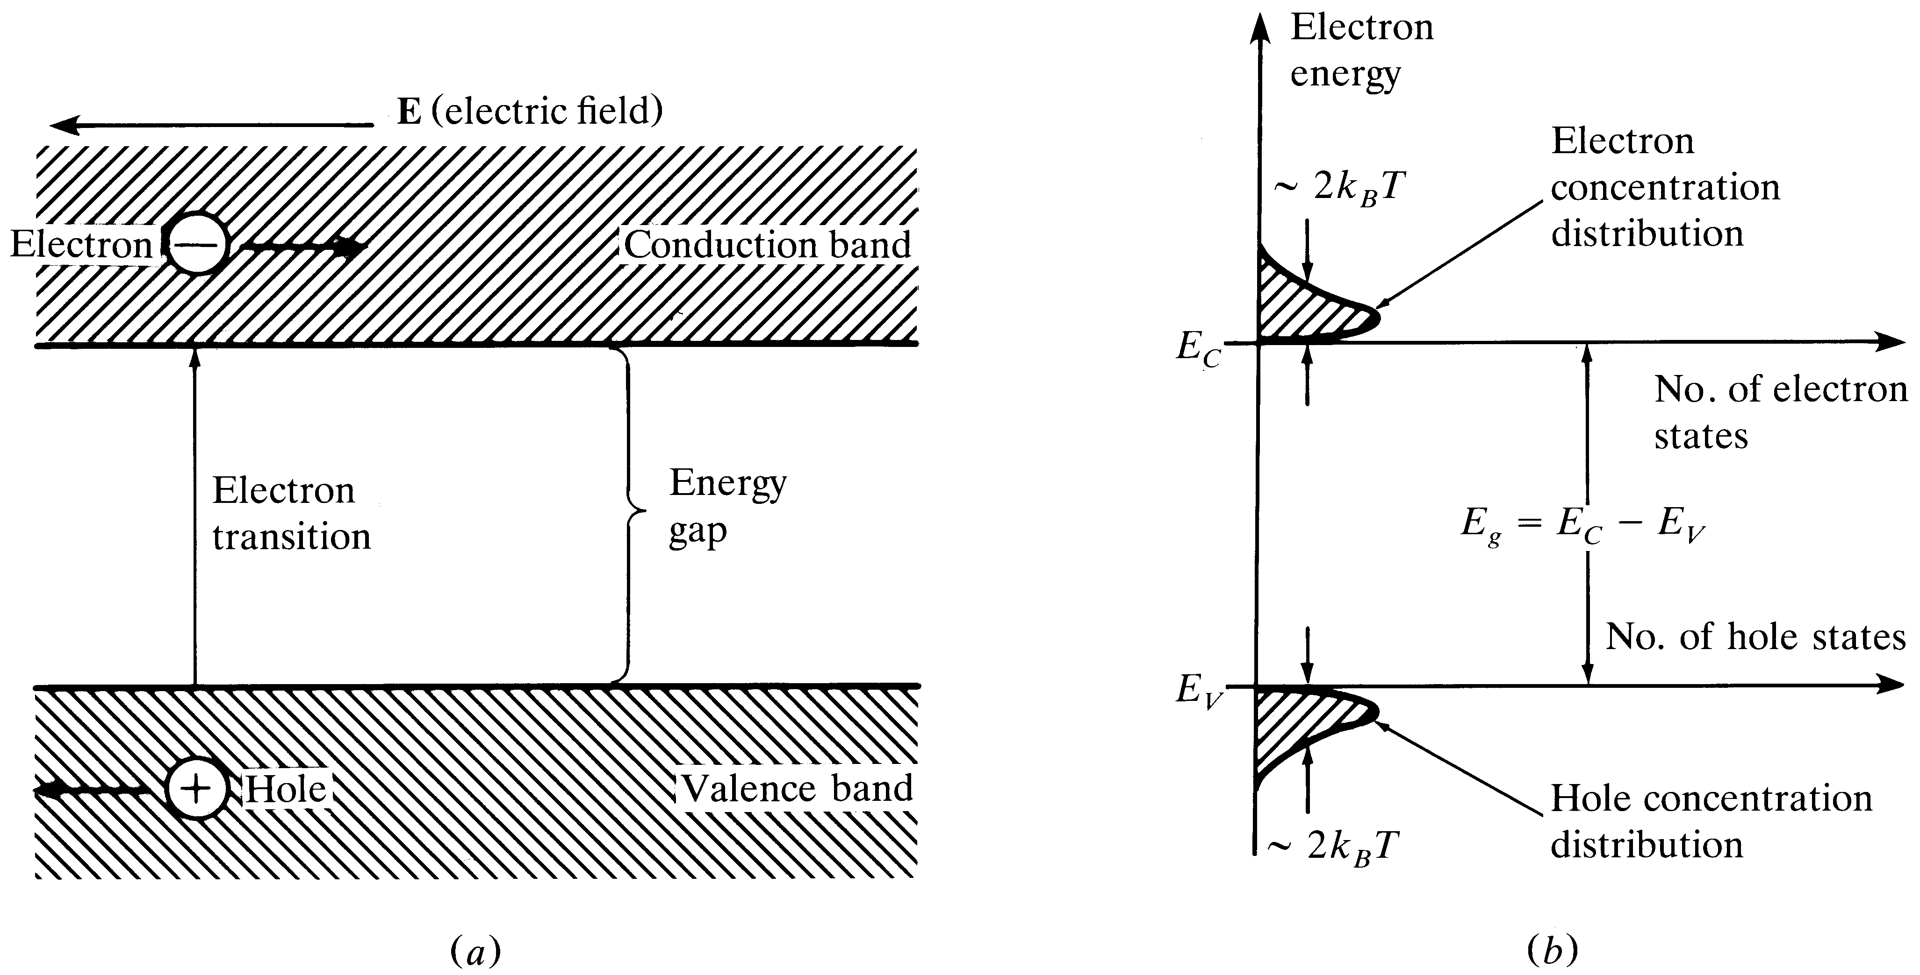
Energy-Bands
In a pure Gp. IV material, equal number of holes and electrons
exist at different energy levels.
Notes:
1

Slide 9
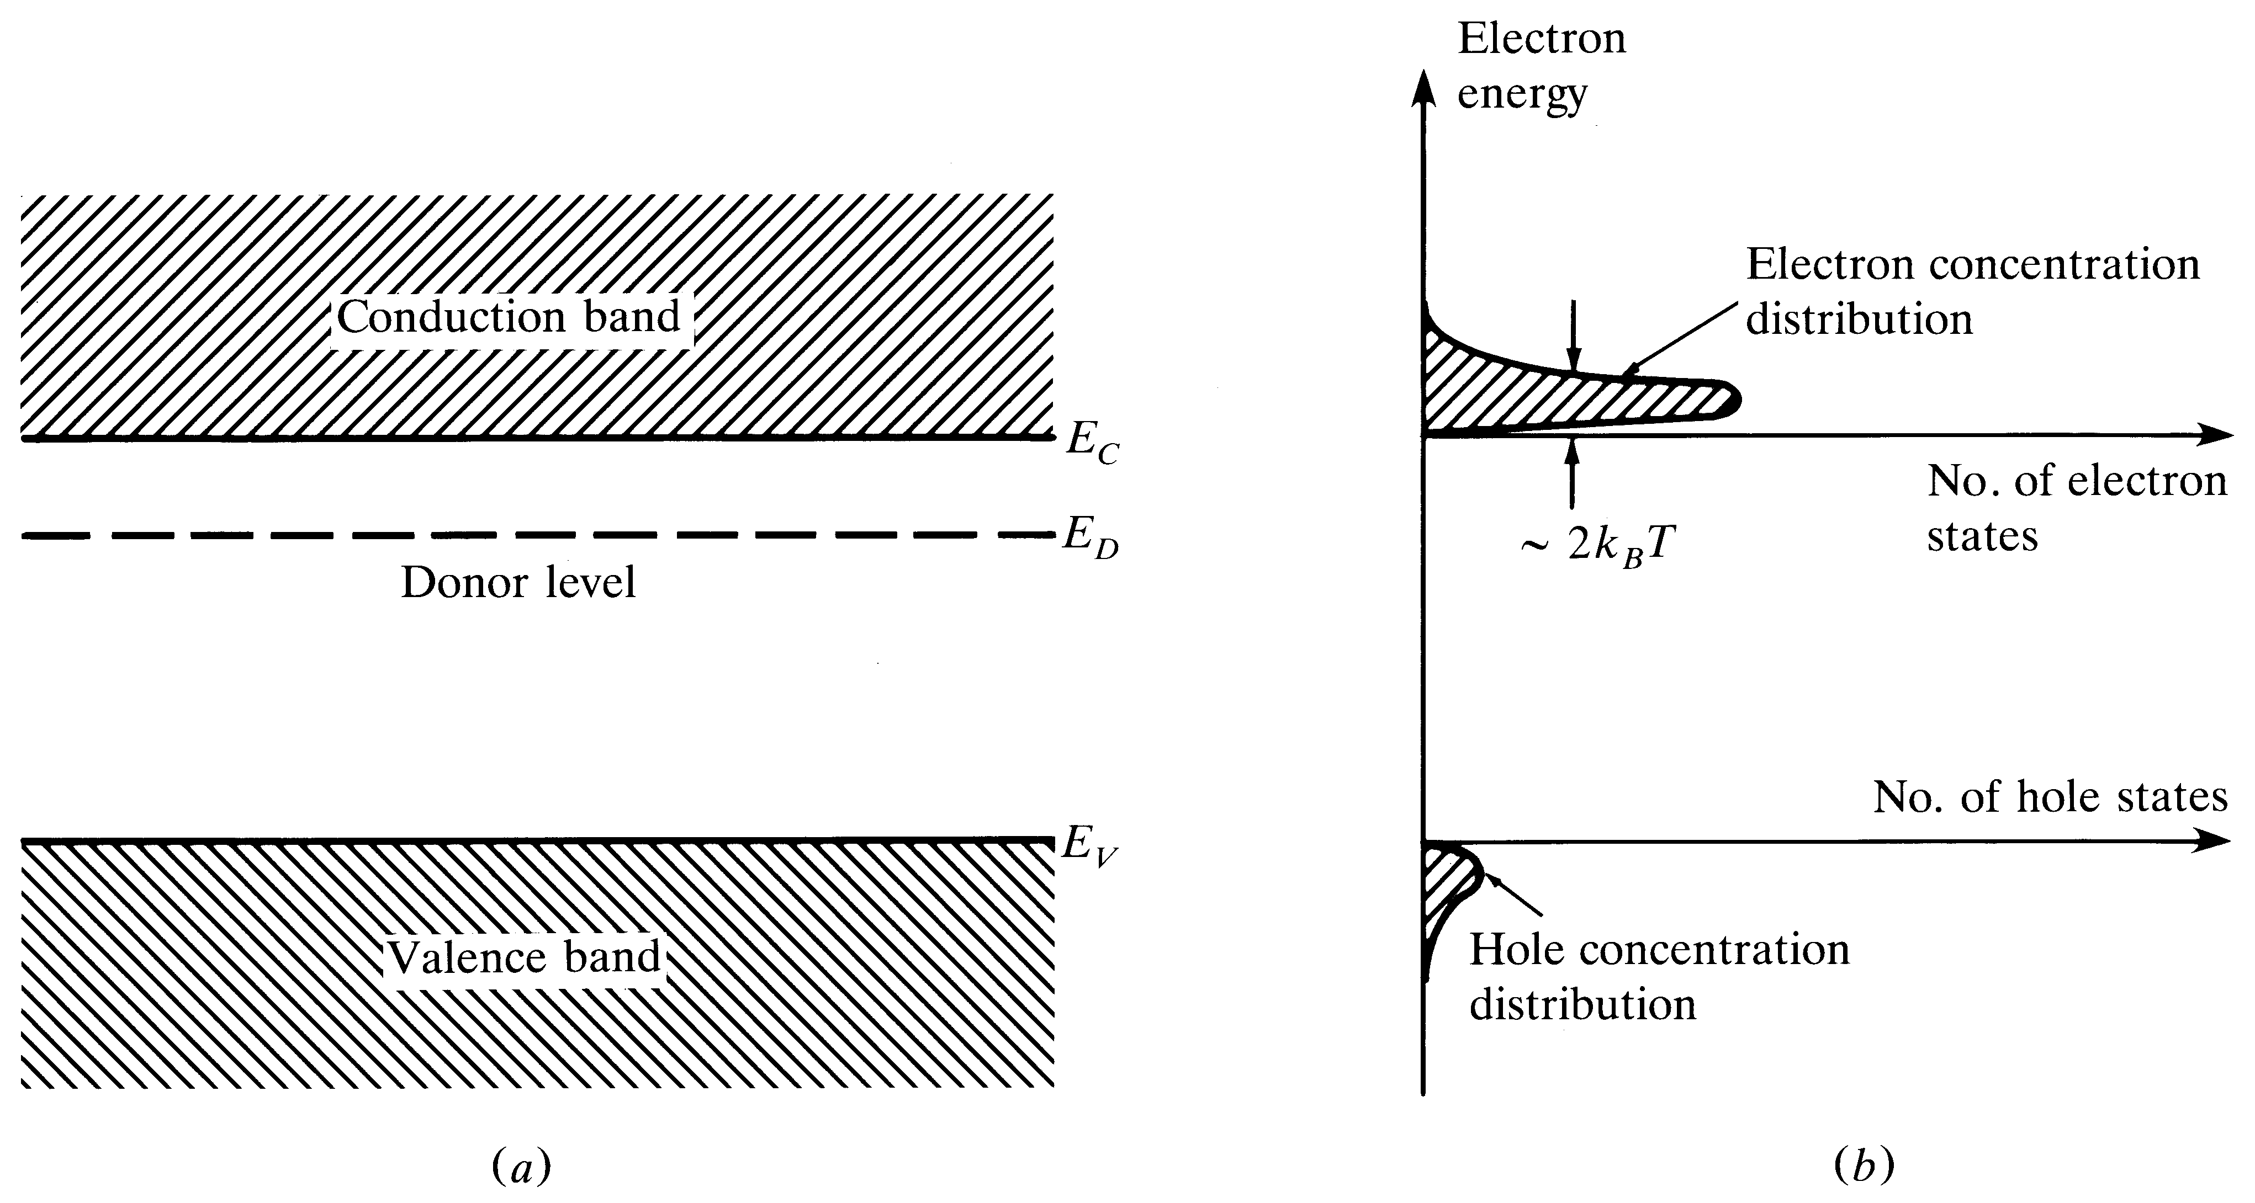
n-type material
Adding group V impurity will create an n- type material
Notes:
2

Slide 10
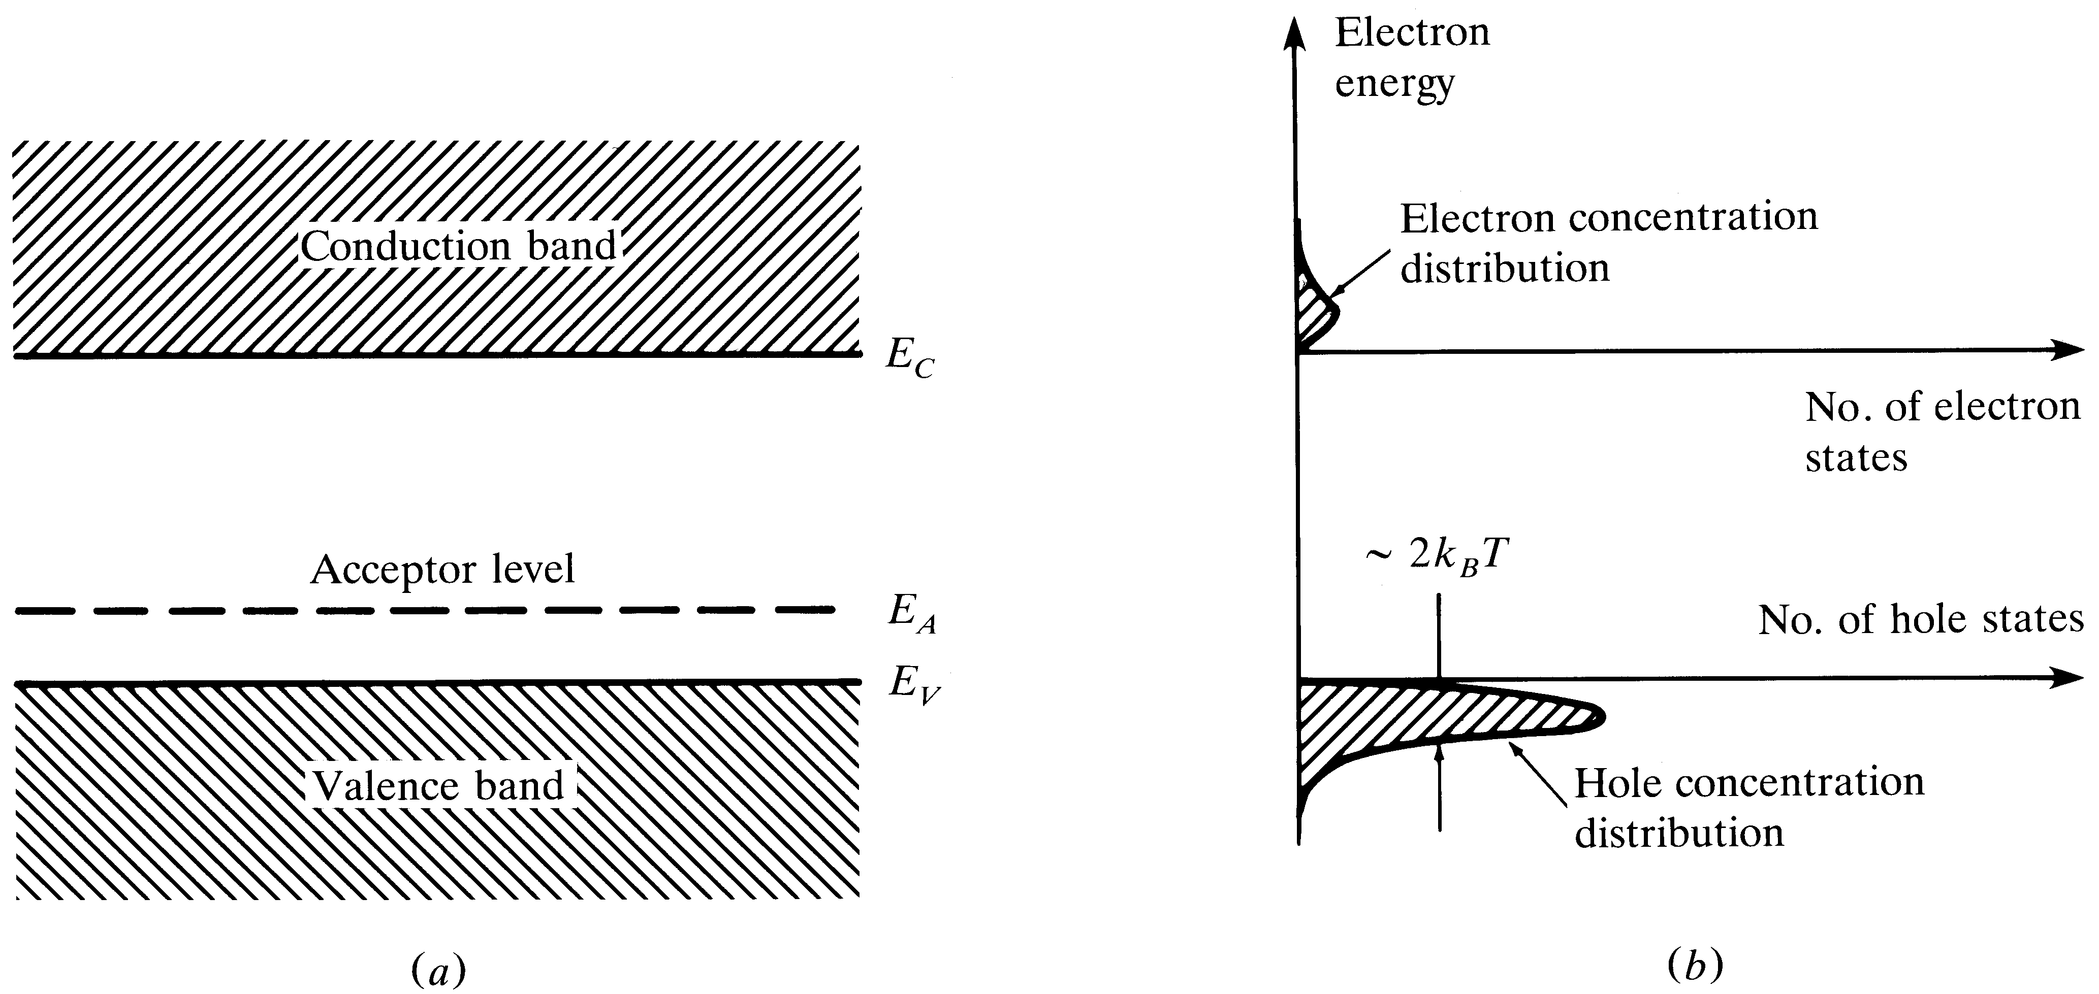
p-type material
Adding group III impurity will create a p-type material
Notes:
3

Slide 11
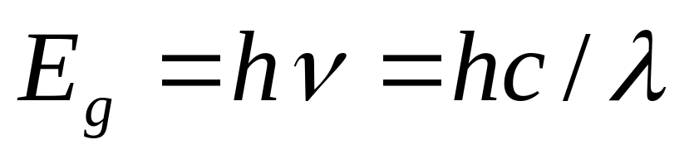
The Light Emitting Diode (LED)
For fiber-optics, the LED should have a high radiance (light intensity), fast response time and a high quantum efficiency
Double or single hetero-structure devices
Surface emitting (diffused radiation) Vs Edge emitting (more directional) LED’s
Emitted wavelength depends on bandgap energy

Slide 12
Heterojunction
Heterojunction is the advanced junction design to reduce diffraction loss in the optical cavity.
This is accomplished by modification of the laser material to control the index of refraction of the cavity and the width of the junction.

Slide 13
The p-n junction of the basic GaAs LED/laser described before is called a homojunction because only one type of semiconductor material is used in the junction with different dopants to produce the junction itself.
The index of refraction of the material depends upon the impurity used and the doping level.

Slide 14
The Heterojunction region is actually lightly doped with p-type material and has the highest index of refraction.
The n-type material and the more heavily doped p-type material both have lower indices of refraction.
This produces a light pipe effect that helps to confine the laser light to the active junction region. In the homojunction, however, this index difference is low and much light is lost.

Slide 15
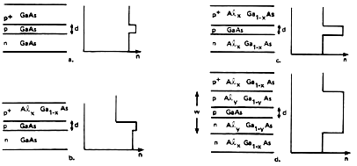
Gallium Arsenide-Aluminum Gallium Arsenide Heterojunction
Structure and index of refraction n for various types of junctions in gallium arsenide with a junction width d.
(a) is for a homojunction.
(b) is for a gallium arsenide-aluminum gallium arsenide single heterojunction.
(c) is for a gallium arsenide-aluminum gallium arsenide double heterojunction with improved optical confinement.
(d) is for a double heterojunction with a large optical cavity of width w.

Slide 16
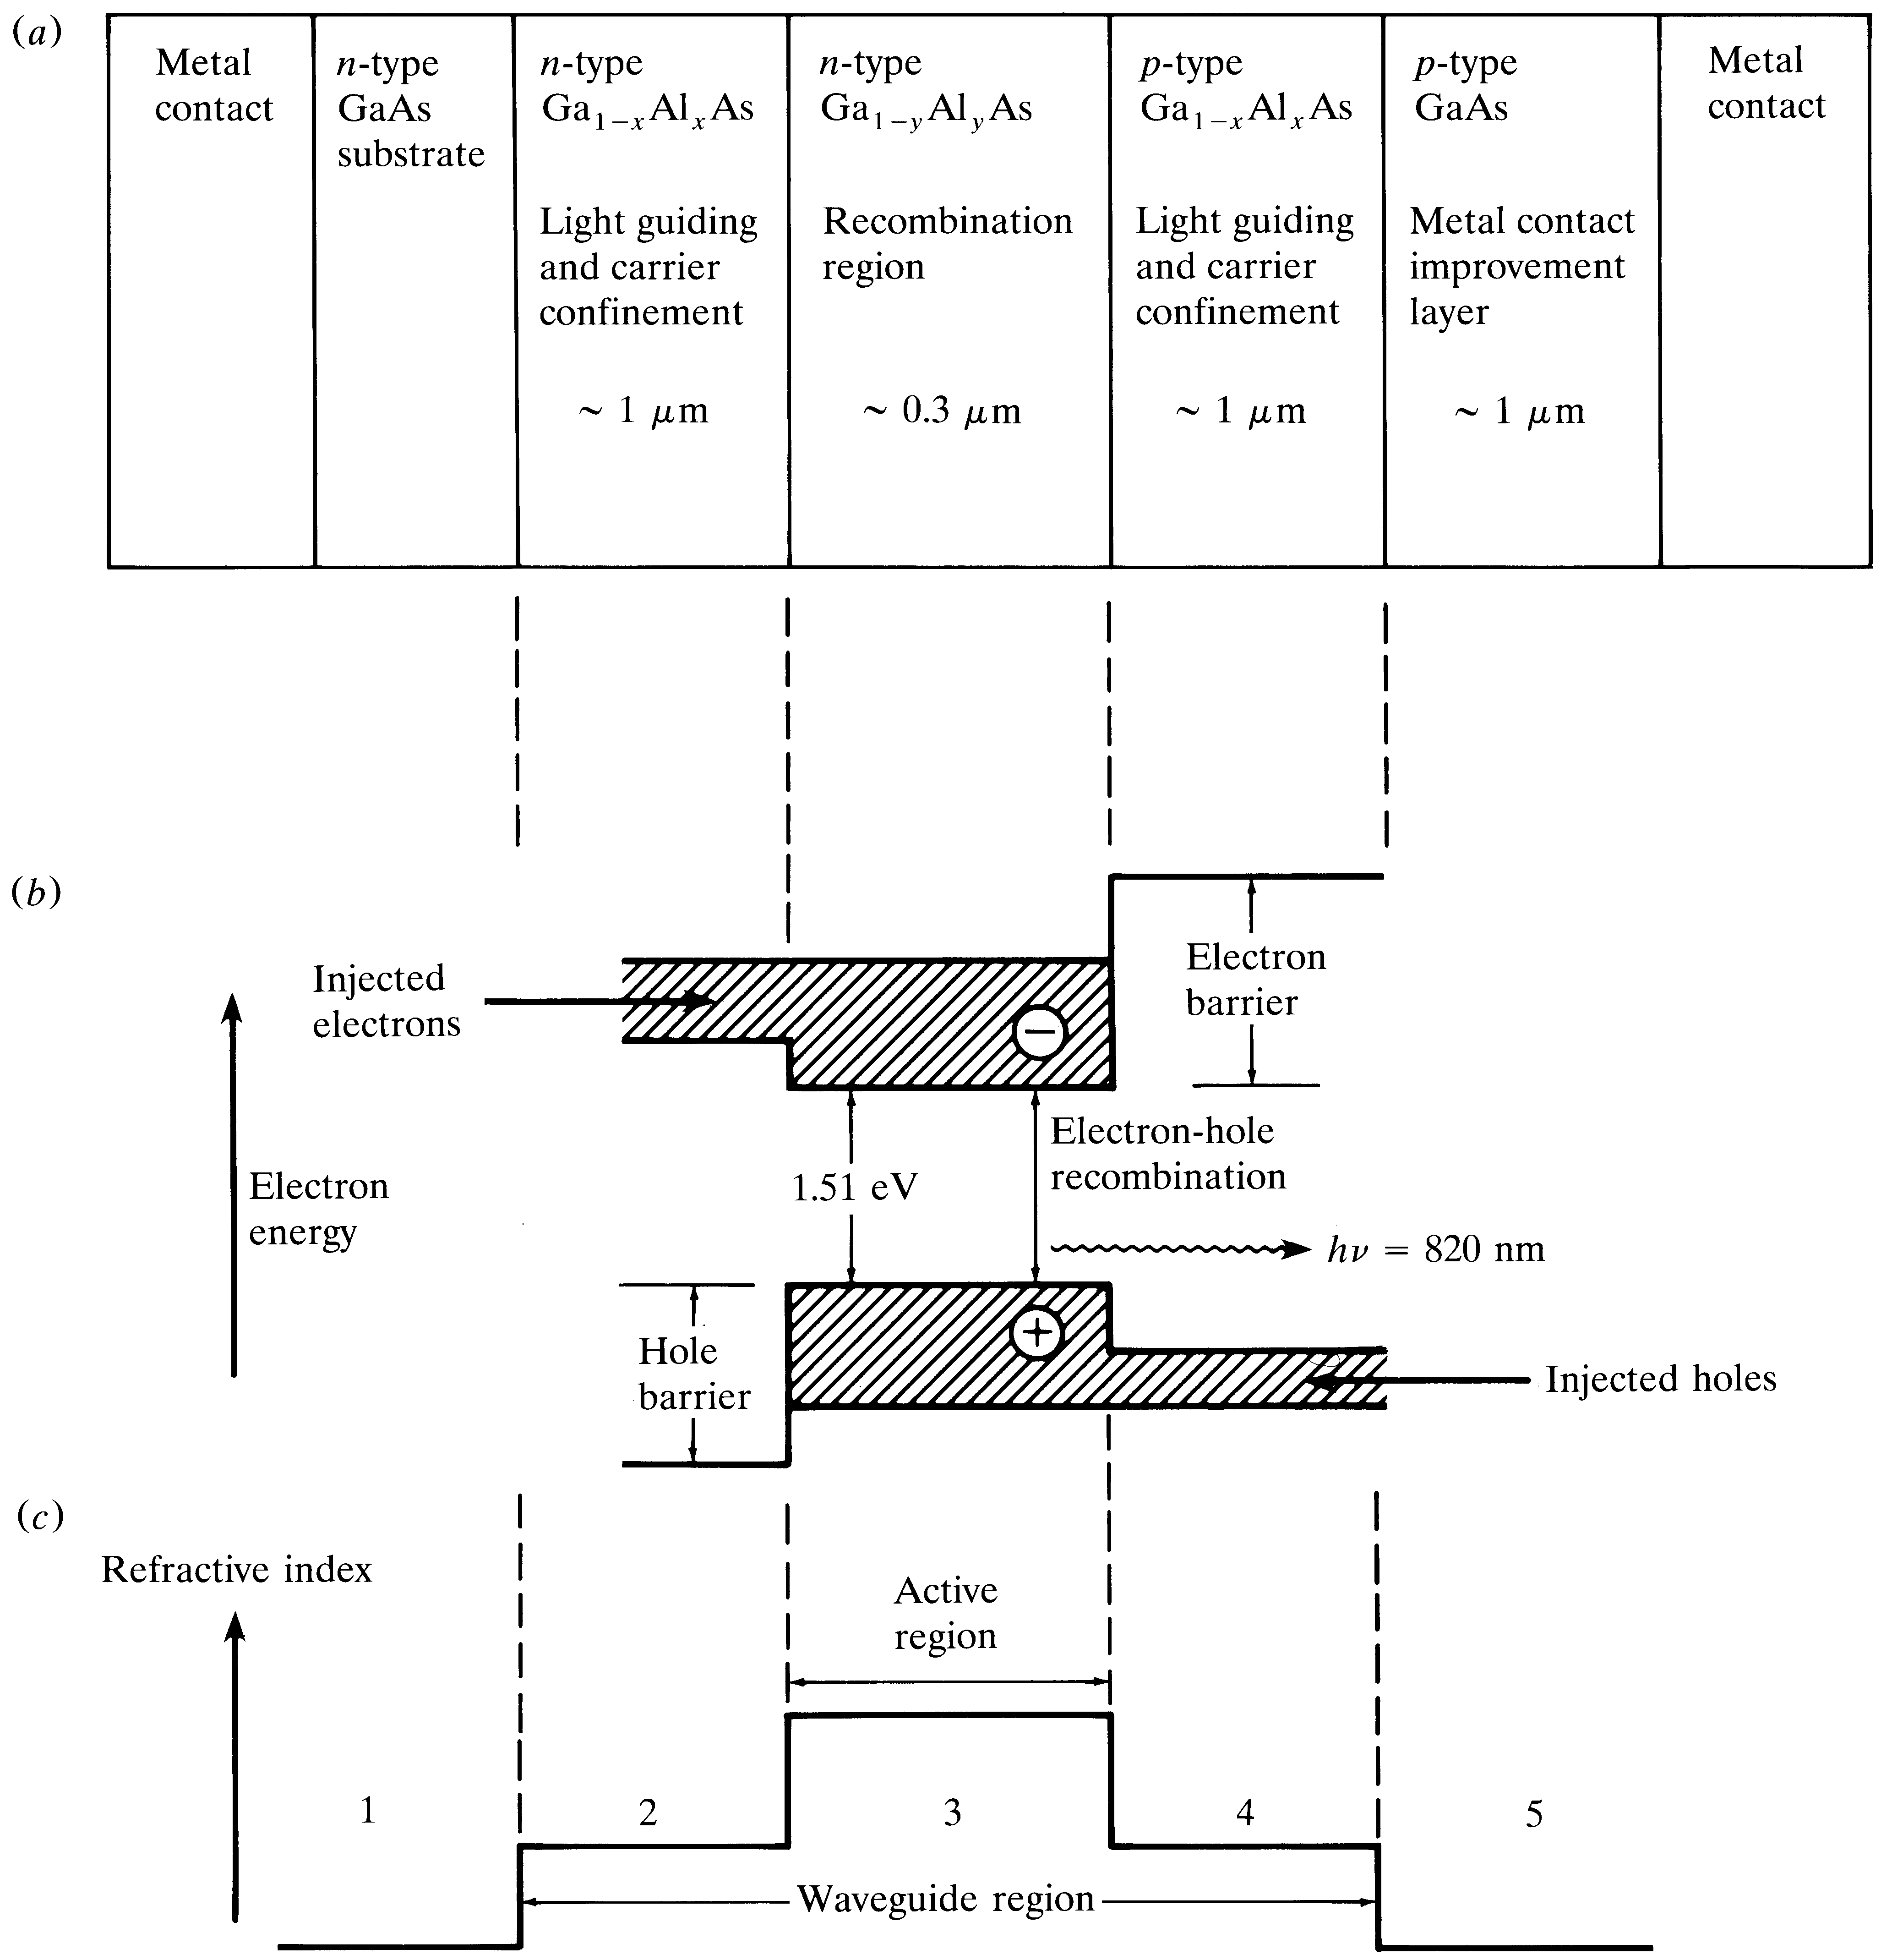
Double-heterostructure configuration

Slide 17
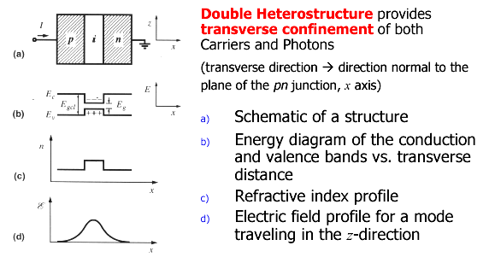
Structure of a Generic Light Emitter:
Double-Heterostructure Device

Slide 18
OPERATING WAVELENGTH
Fiber optic communication systems operate in the
850-nm,
1300-nm, and
1550-nm wavelength windows.
Semiconductor sources are designed to operate at wavelengths that minimize optical fiber absorption and maximize system bandwidth

Slide 19
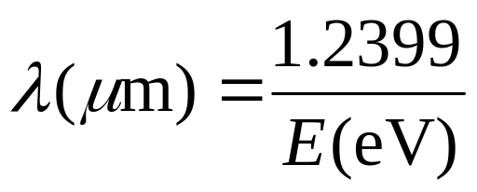
LED Wavelength
λ = hc/E(eV)
λ = wavelength in microns
H = Planks constant
C = speed of light
E = Photon energy in eV

Slide 20
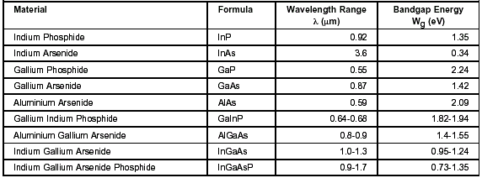
Bandgap Energy and Possible Wavelength Ranges in Various Materials

Slide 21
SEMICONDUCTOR LIGHT-EMITTING DIODES
Semiconductor LEDs emit incoherent light.
Spontaneous emission of light in semiconductor LEDs produces light waves that lack a fixed-phase relationship. Light waves that lack a fixed-phase relationship are referred to as incoherent light

Slide 22
SEMICONDUCTOR LIGHT-EMITTING DIODES Cont…
The use of LEDs in single mode systems is severely limited because they emit unfocused incoherent light.
Even LEDs developed for single mode systems are unable to launch sufficient optical power into single mode fibers for many applications.
LEDs are the preferred optical source for multimode systems because they can launch sufficient power at a lower cost than semiconductor LDs.

Slide 23
Semiconductor LDs
Semiconductor LDs emit coherent light.
LDs produce light waves with a fixed-phase relationship (both spatial and temporal) between points on the electromagnetic wave.
Light waves having a fixed-phase relationship are referred to as coherent light.

Slide 24
Semiconductor LDs Cont..
Semiconductor LDs emit more focused light than LEDs, they are able to launch optical power into both single mode and multimode optical fibers.
LDs are usually used only in single mode fiber systems because they require more complex driver circuitry and cost more than LEDs.

Slide 25
Produced Optical Power
Optical power produced by optical sources can range from microwatts (μW) for LEDs to tens of milliwatts (mW) for semiconductor LDs.
However, it is not possible to effectively couple all the available optical power into the optical fiber for transmission.

Slide 26
Dependence of coupled power
The amount of optical power coupled into the fiber is the relevant optical power. It depends on the following factors:
The angles over which the light is emitted
The size of the source's light-emitting area relative to the fiber core size
The alignment of the source and fiber
The coupling characteristics of the fiber (such as the NA and the refractive index profile)

Slide 27
Typically, semiconductor lasers emit light spread out over an angle of 10 to 15 degrees.
Semiconductor LEDs emit light spread out at even larger angles.
Coupling losses of several decibels can easily occur when coupling light from an optical source to a fiber, especially with LEDs.
Source-to-fiber coupling efficiency is a measure of the relevant optical power.
The coupling efficiency depends on the type of fiber that is attached to the optical source.
Coupling efficiency also depends on the coupling technique.

Slide 28
Current flowing through a semiconductor optical source causes it to produce light.
LEDs generally produce light through spontaneous emission when a current is passed through them.

Slide 29
Spontaneous Emission
Spontaneous emission is the random generation of photons within the active layer of the LED. The emitted photons move in random directions. Only a certain percentage of the photons exit the semiconductor and are coupled into the fiber. Many of the photons are absorbed by the LED materials and the energy dissipated as heat.

Slide 30
LIGHT-EMITTING DIODES
A light-emitting diode (LED) is a semiconductor device that emits incoherent light, through spontaneous emission, when a current is passed through it. Typically LEDs for the 850-nm region are fabricated using GaAs and AlGaAs. LEDs for the 1300-nm and 1550-nm regions are fabricated using InGaAsP and InP.

Slide 31
Types of LED
The basic LED types used for fiber optic communication systems are
Surface-emitting LED (SLED),
Edge-emitting LED (ELED), and

Slide 32
LED performance differences (1)
LED performance differences help link designers decide which device is appropriate for the intended application.
For short-distance (0 to 3 km), low-data-rate fiber optic systems, SLEDs and ELEDs are the preferred optical source.
Typically, SLEDs operate efficiently for bit rates up to 250 megabits per second (Mb/s). Because SLEDs emit light over a wide area (wide far-field angle), they are almost exclusively used in multimode systems.

Slide 33
LED performance differences (2)
For medium-distance, medium-data-rate systems, ELEDs are preferred.
ELEDs may be modulated at rates up to 400 Mb/s. ELEDs may be used for both single mode and multimode fiber systems.
Both SLDs and ELEDs are used in long-distance, high-data-rate systems. SLDs are ELED-based diodes designed to operate in the superluminescence mode.
SLDs may be modulated at bit rates of over 400 Mb/s.

Slide 34
Surface-Emitting LEDs
The surface-emitting LED is also known as the Burrus LED in honor of C. A. Burrus, its developer.
In SLEDs, the size of the primary active region is limited to a small circular area of 20 μm to 50 μm in diameter.
The active region is the portion of the LED where photons are emitted. The primary active region is below the surface of the semiconductor substrate perpendicular to the axis of the fiber.
A well is etched into the substrate to allow direct coupling of the emitted light to the optical fiber. The etched well allows the optical fiber to come into close contact with the emitting surface.

Slide 35
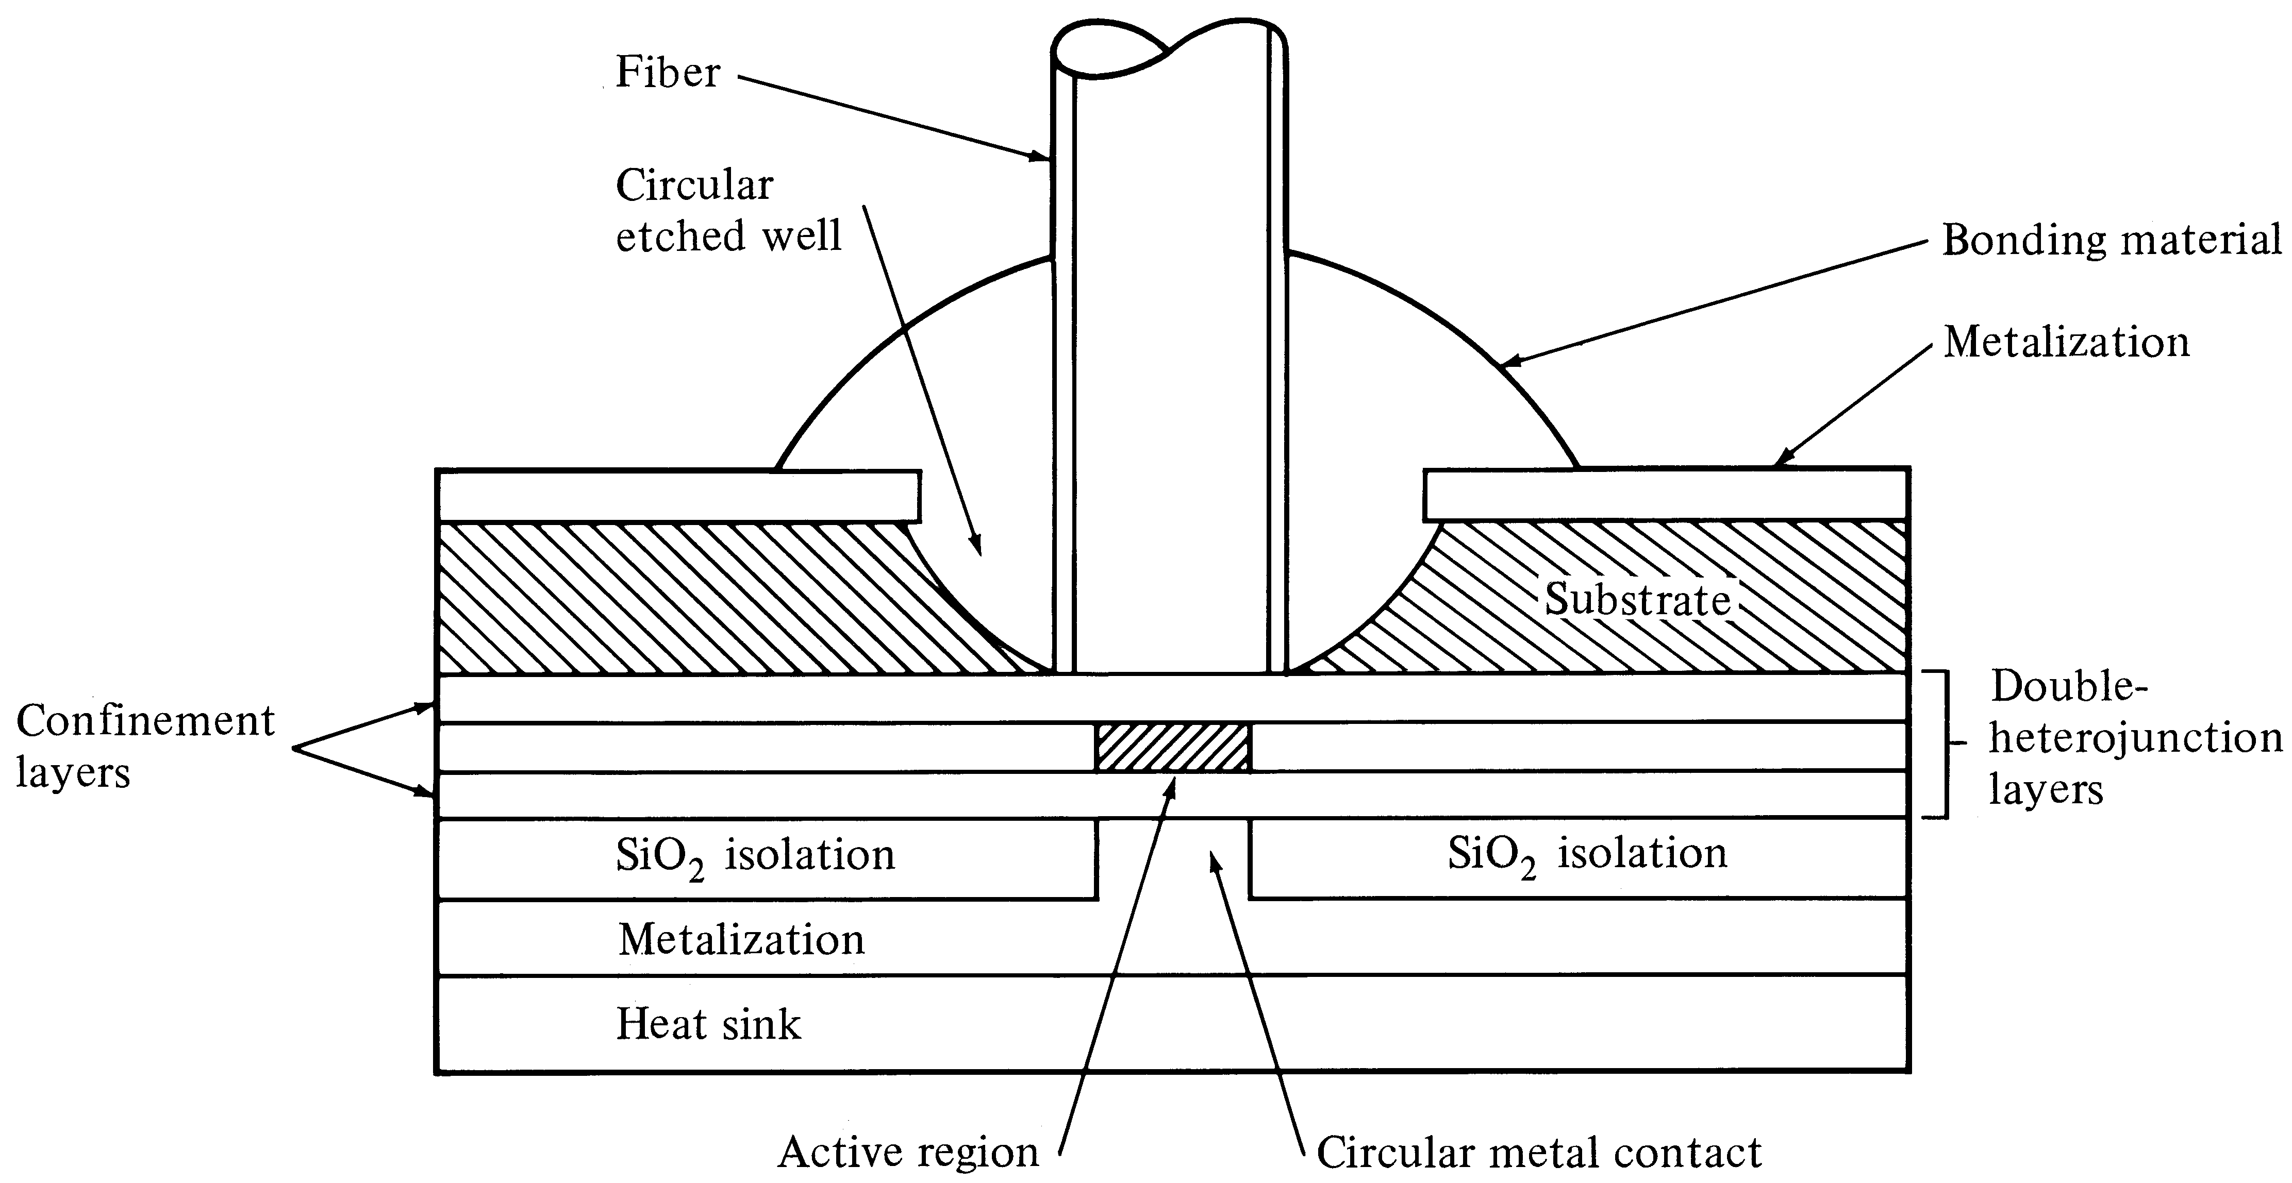
Surface-emitting LED

Slide 36
Edge-emitting LED

Slide 37
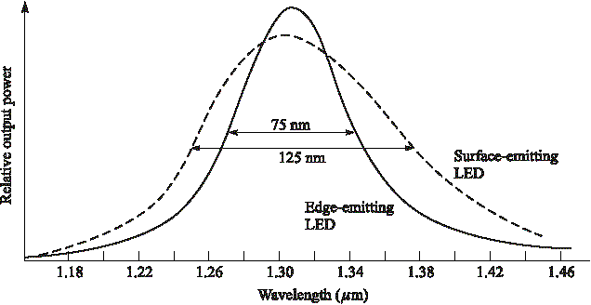
LED Spectral Width
Edge emitting LED’s have slightly narrow line width

Slide 38
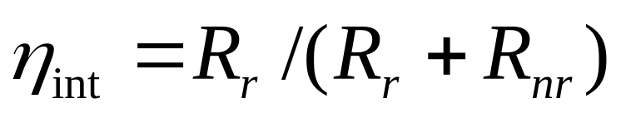
Quantum Efficiency
Internal quantum efficiency is the ratio between the radiative recombination rate and the sum of radiative and nonradiative recombination rates
For exponential decay of excess carriers, the radiative recombination lifetime is n/R_{r} and the nonradiative recombination lifetime is n/R_{nr}

Slide 39
Internal Efficiency
If the current injected into the LED is I, then the total number of recombination per second is, R_{r}+R_{nr} = I/q where, q is the charge of an electron.
That is, R_{r} = η_{int}I/q.
Since R_{r} is the total number of photons generated per second, the optical power generated internal to the LED depends on the internal quantum efficiency

Slide 40
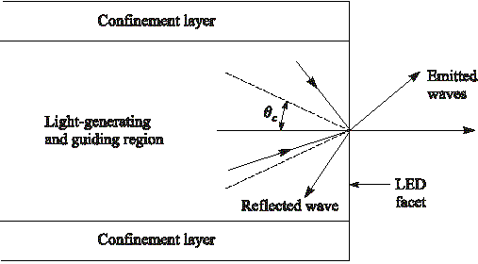
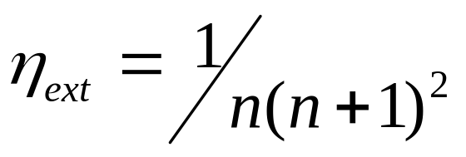
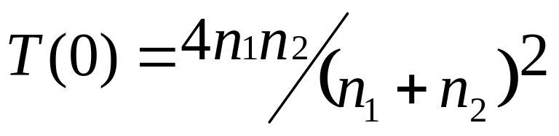
External Efficiency
n₂
n₁
Light
emission
cone
External Efficiency for air
n₂=1, n₁ = n
Fresnel Transmission Coefficient

Slide 41
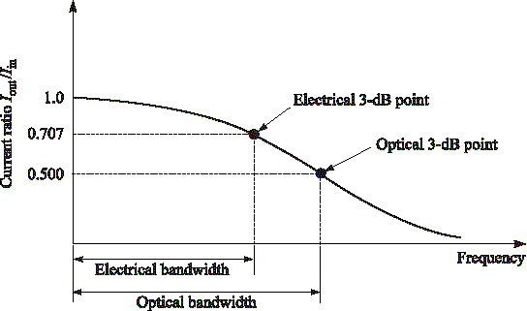
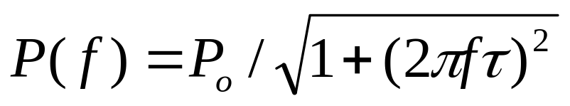
3-dB bandwidths
Optical Power ∝ I(f); Electrical Power ∝ I²(f)
Electrical Loss = 2 x Optical Loss

Slide 42
Drawbacks of LED
Large line width (30-40 nm)
Large beam width (Low coupling to the fiber)
Low output power
Low E/O conversion efficiency
Advantages
Robust
Linear

Slide 43
The LASER
Light Amplification by ‘Stimulated Emission’ and Radiation (L A S E R)
Coherent light (stimulated emission)
Narrow beam width (very focused beam)
High output power (amplification)
Narrow line width because only few wavelength will experience a positive feedback and get amplified (optical filtering)

Slide 44
Fundamental Lasing Operation
Absorption: An atom in the ground state might absorb a photon emitted by another atom, thus making a transition to an excited state.
Spontaneous Emission: Random emission of a photon, which enables the atom to relax to the ground state.
Stimulated Emission: An atom in an excited state might be stimulated to emit a photon by another incident photon.

Slide 45


Slide 46
In Stimulated Emission incident and stimulated photons will have
Identical energy → Identical wavelength → Narrow linewidth
Identical direction → Narrow beam width
Identical phase → Coherence and
Identical polarization

Slide 47
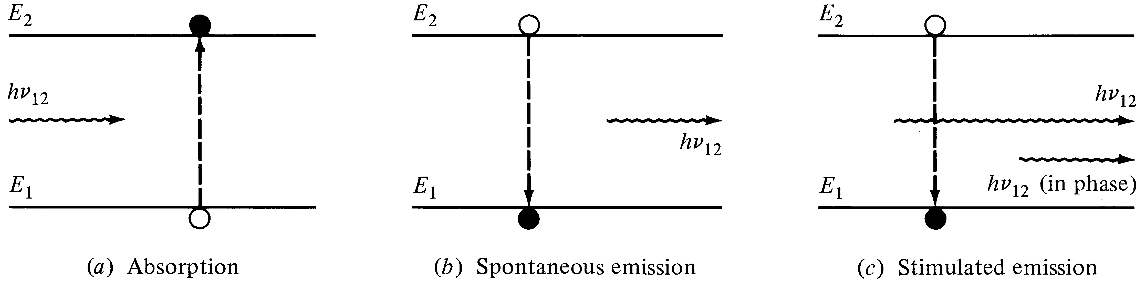
Laser Transition Processes
(Stimulated and Spontaneous Emission)
Energy absorbed from the incoming photon | Random release of energy | Coherent release of energy

Slide 48
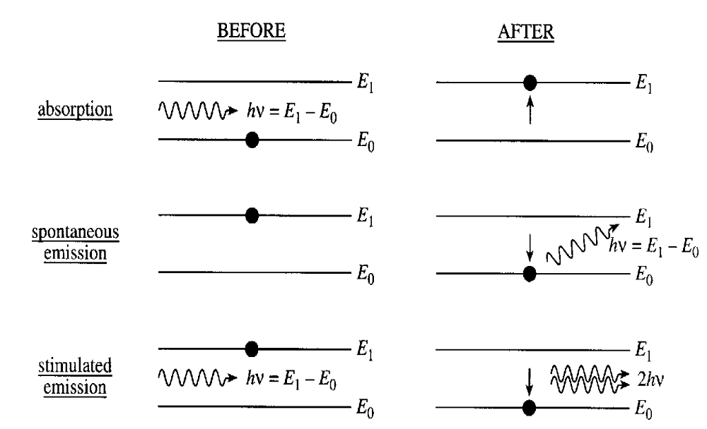
Stimulated Emission

Slide 49
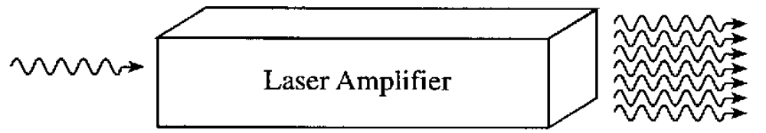
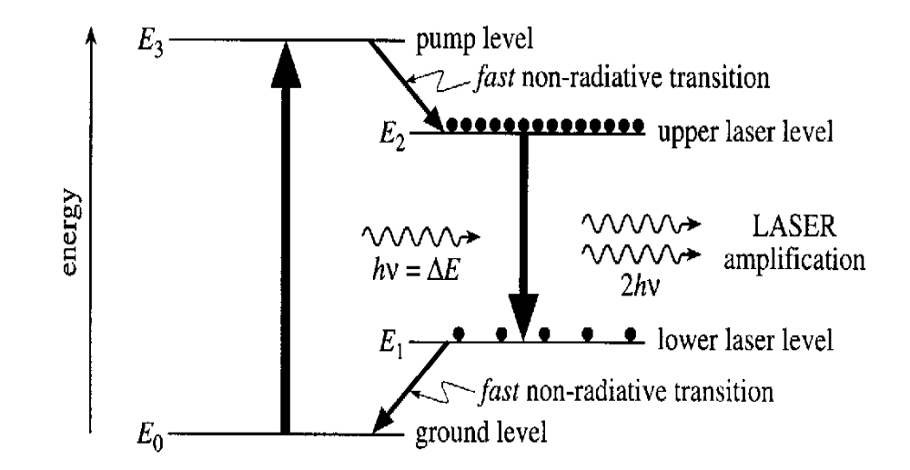

Slide 50
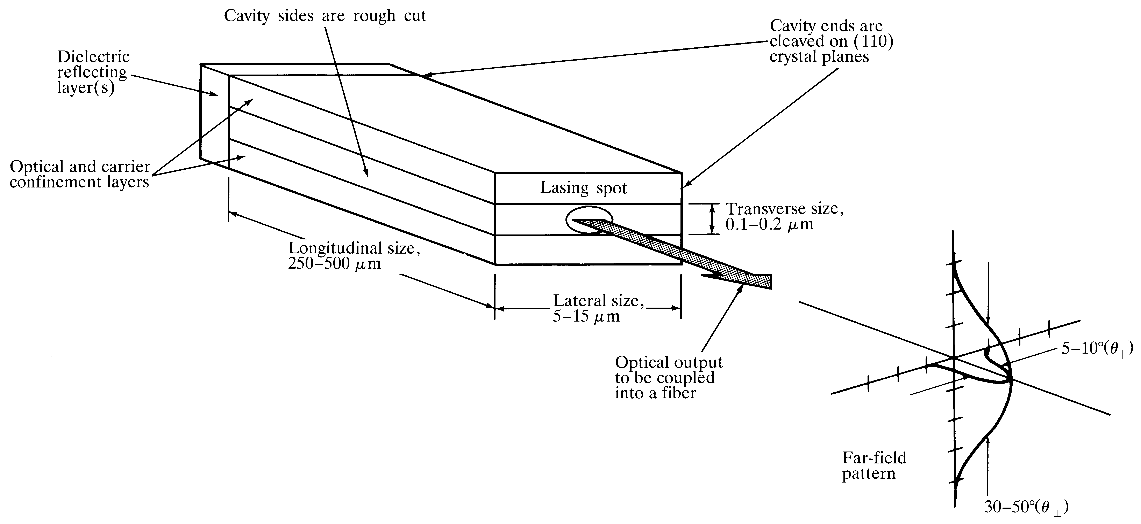
Fabry-Perot Laser (resonator) cavity

Slide 51
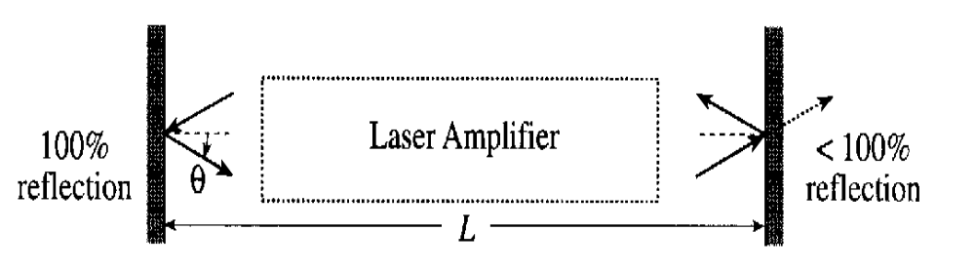
Mirror Reflections

Slide 52
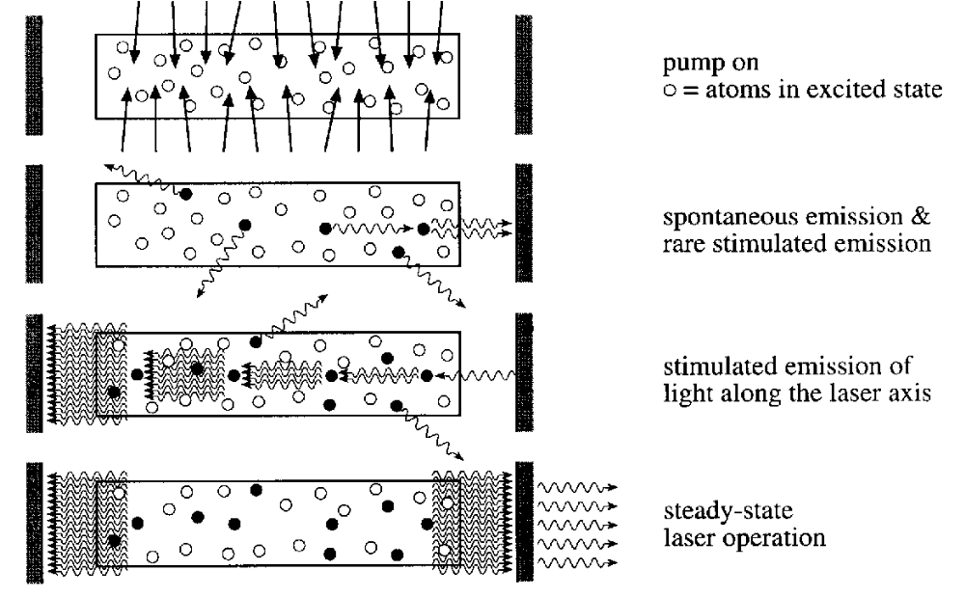
How a Laser Works

Slide 53
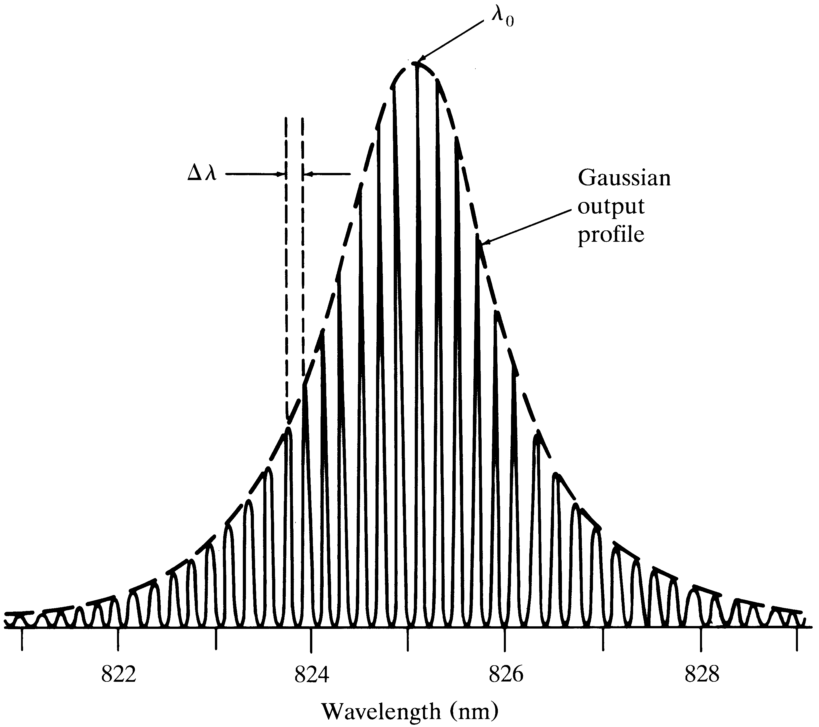
Multimode Laser Output
Spectrum
(Center Wavelength)
Mode
Separation
g(λ)
Longitudinal
Modes

Slide 54
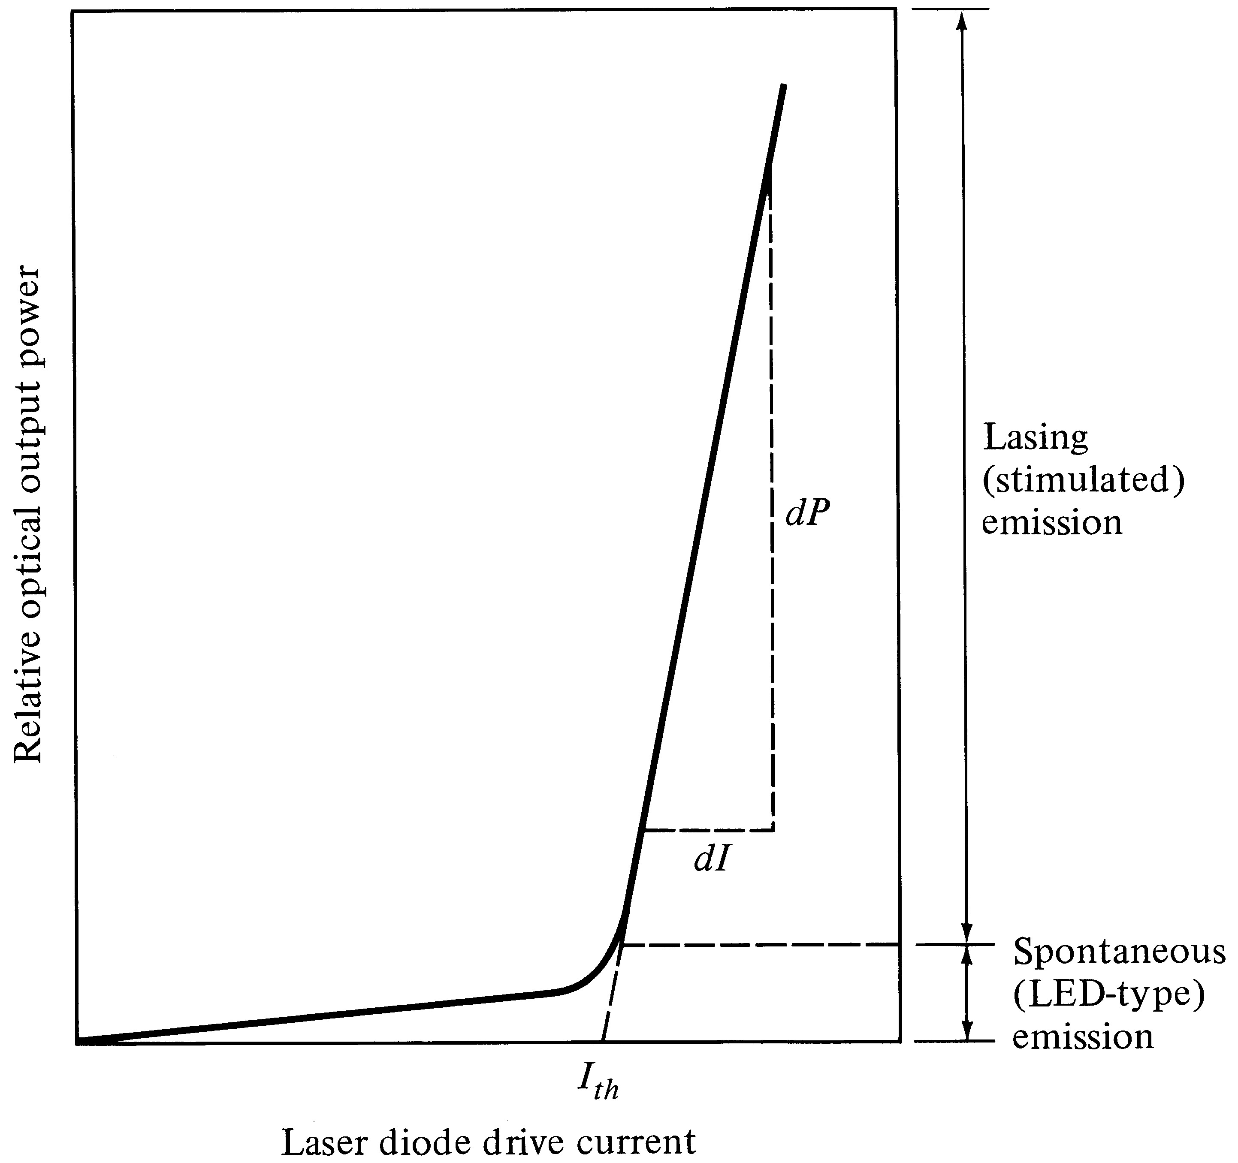
Optical output vs. drive current of a laser
External Efficiency
Depends on the slope
Threshold Current

Slide 55
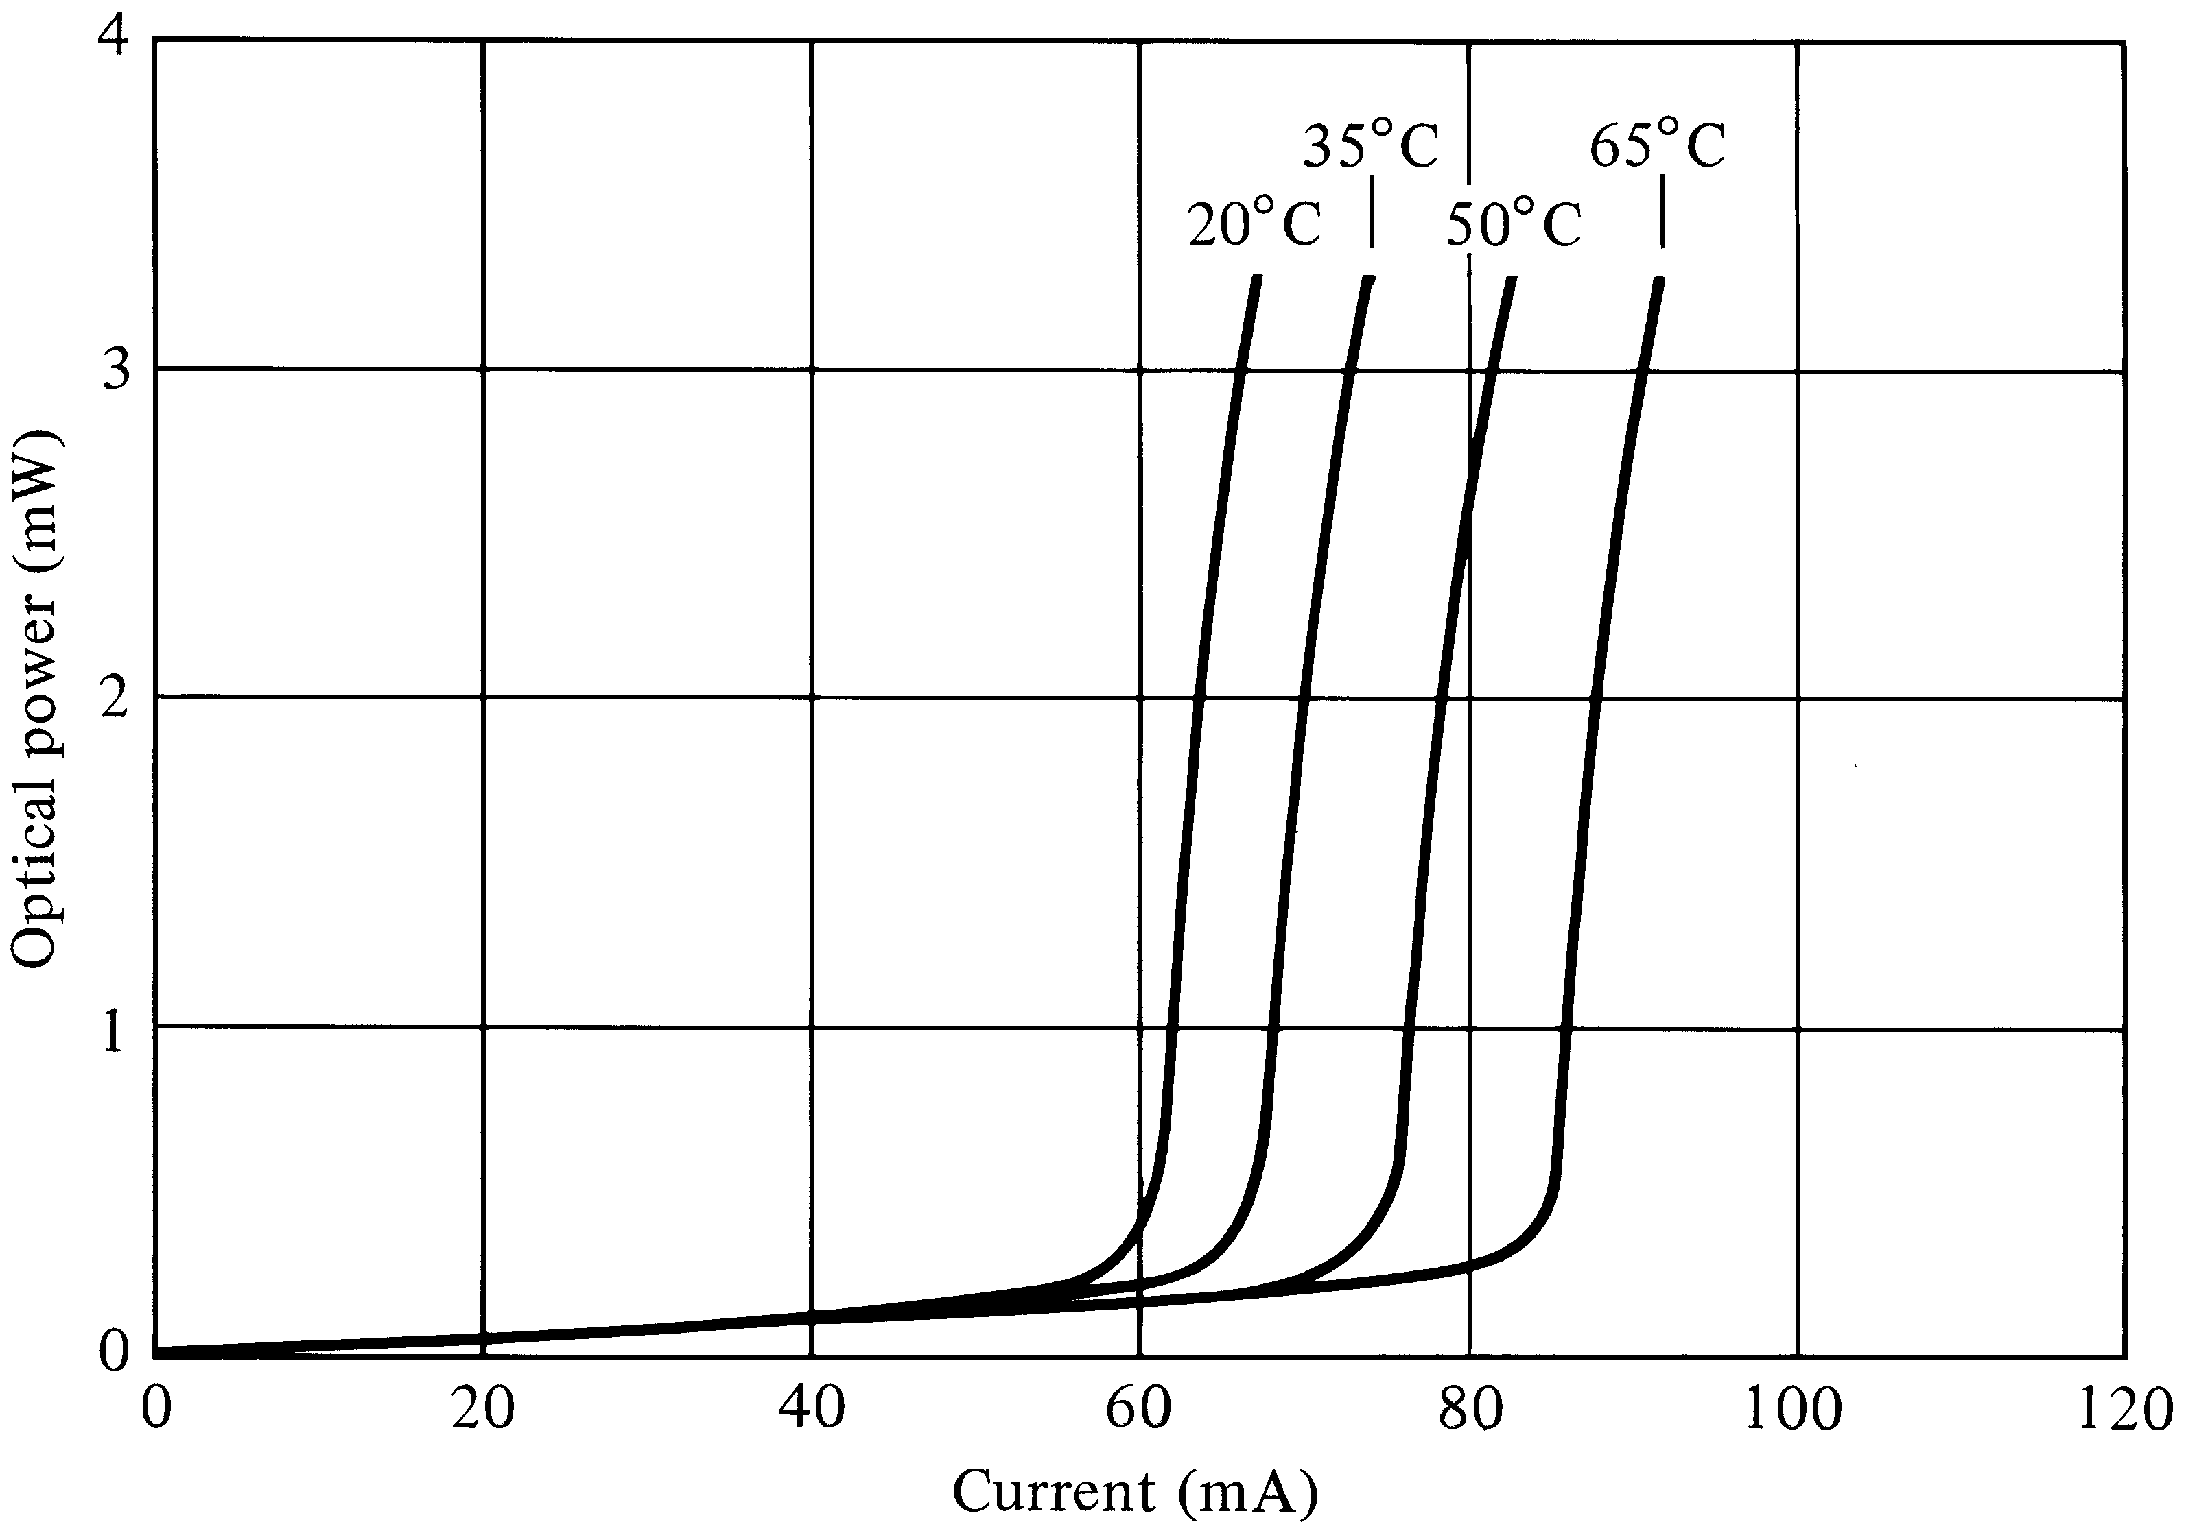
Laser threshold depends on Temperature

Slide 56
Modulation of Optical Sources
Optical sources can be modulated either directly or externally.
Direct modulation is done by modulating the driving current according to the message signal (digital or analog)
In external modulation, the laser emits continuous wave (CW) light and the modulation is done in the fiber

Slide 57
Why Modulation
A communication link is established by transmission of information reliably
Optical modulation is embedding the information on the optical carrier for this purpose
The information can be digital (1,0) or analog (a continuous waveform)
The bit error rate (BER) is the performance measure in digital systems
The signal to noise ratio (SNR) is the performance measure in analog systems

Slide 58
Important parameters used to characterize and compare different modulators
Modulation efficiency: Defined differently depending on if we modulate intensity, phase or frequency. For intensity it is defined as (Imax – Imin)/Imax.
Modulation depth: For intensity modulation it is defined in decibel by 10 log (Imax/Imin).
Modulation bandwidth: Defined as the high frequency at which the efficiency has fallen by 3dB.
Power consumption: Simply the power consumption per unit bandwidth needed for (intensity) modulation.

Slide 59
Types of Optical Modulation
Direct modulation is done by superimposing the modulating (message) signal on the driving current
External modulation is done after the light is generated; the laser is driven by a dc current and the modulation is done after that separately
Both these schemes can be done with either digital or analog modulating signals

Slide 60
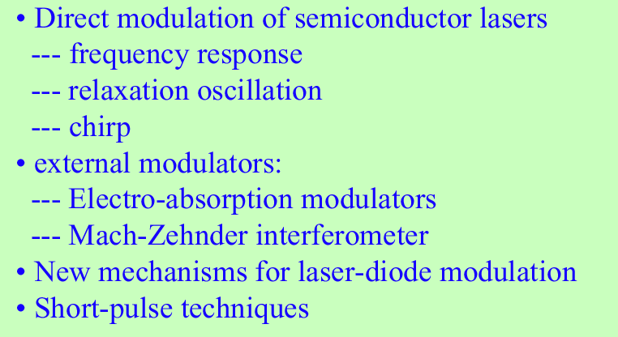
Optical Communication

Slide 61
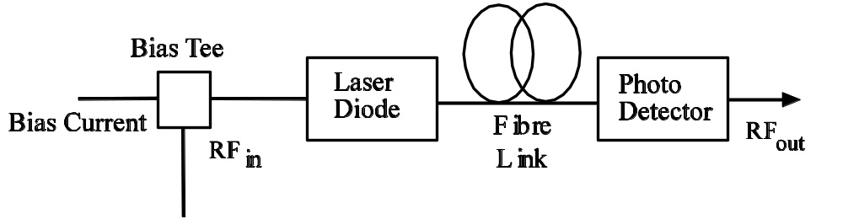
Direct Modulation
The message signal (ac) is superimposed on the bias current (dc) which modulates the laser
Robust and simple, hence widely used
Issues: laser resonance frequency, chirp, turn on delay, clipping and laser nonlinearity

Slide 62
Optical Output vs. Drive Current of a Laser

Slide 63
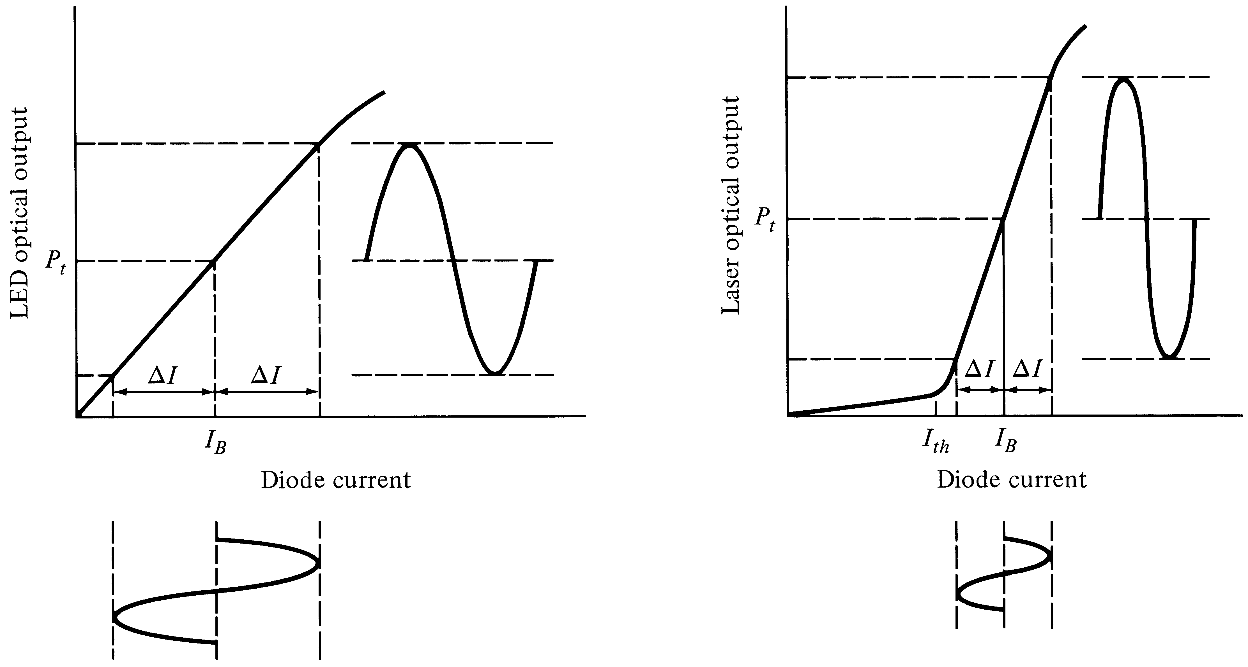
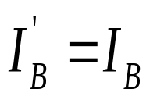
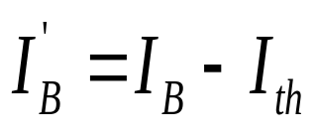
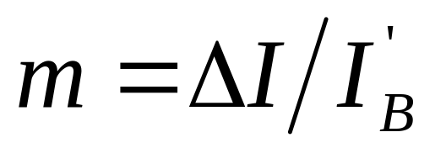
Direct Analog Modulation
LED
LASER
Modulation index (depth)

Slide 64
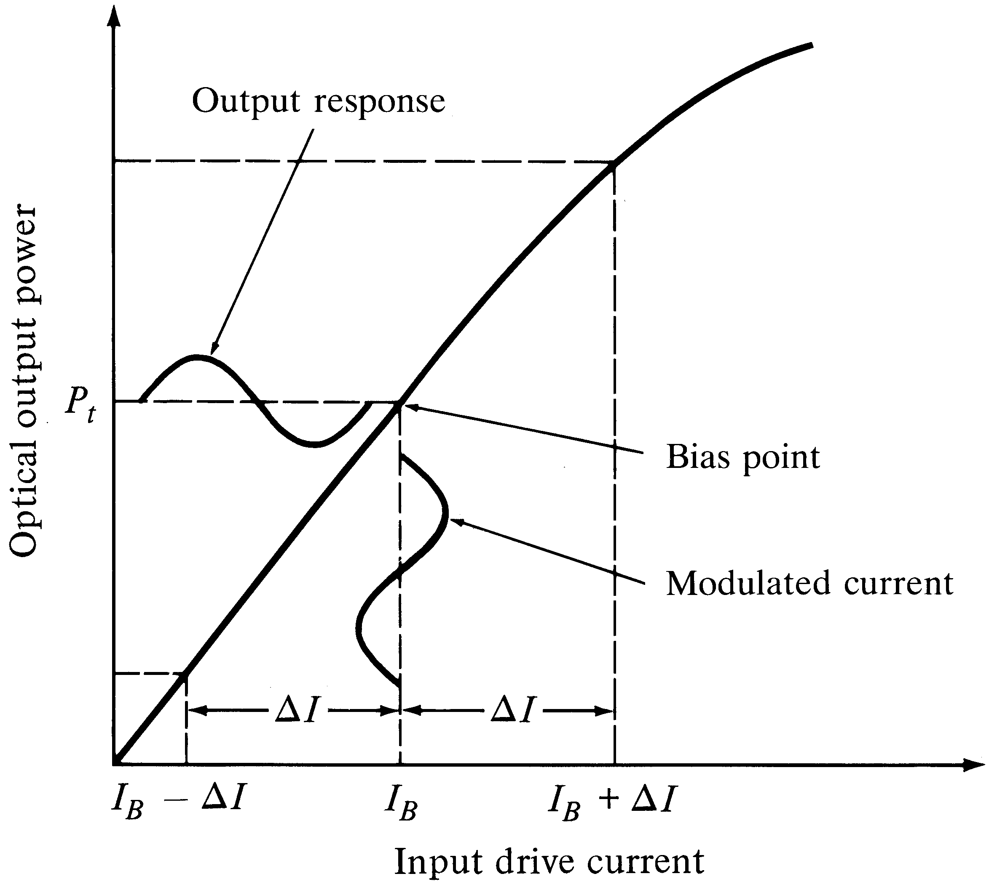
Analog LED Modulation
Note:
No threshold
current
No clipping
No turn on delay

Slide 65
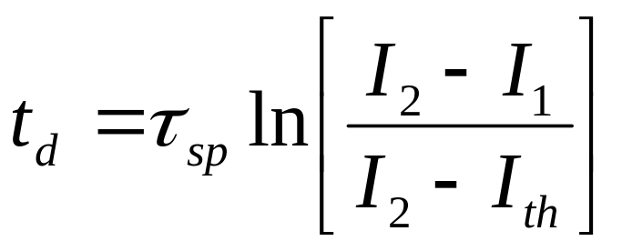
Laser Digital Modulation
Optical
Power
(P)
P(t)
I_{th}
I₁
I₂
t
Current (I)
I(t)
t

Slide 66

Turn on Delay (lasers)
When the driving current suddenly jumps from low (I₁ < I_{th}) to high (I₂ > I_{th}) , (step input), there is a finite time before the laser will turn on
This delay limits bit rate in digital systems
Can you think of any solution?

Slide 67
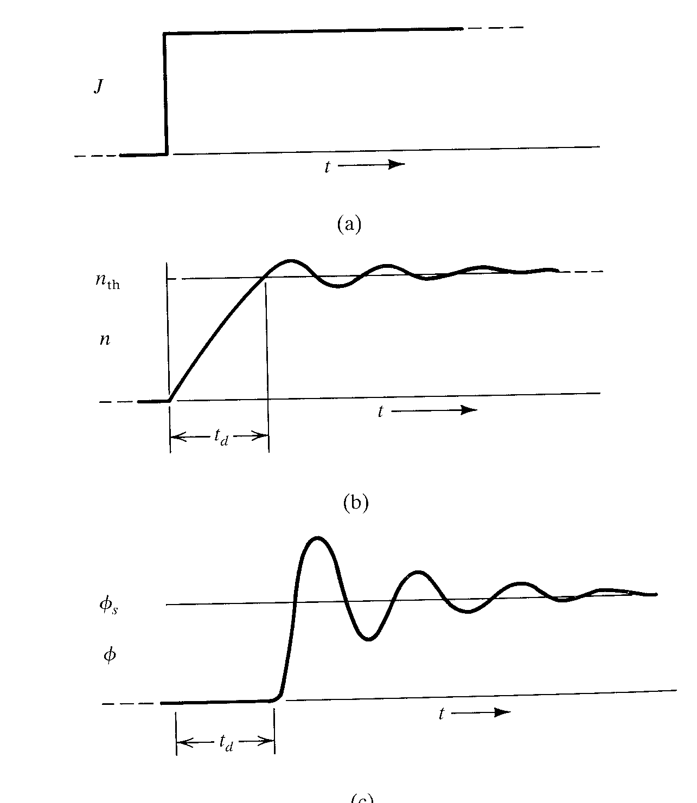
I₂
Input current
  Assume step input
Electron density
  steadily increases until threshold value is reached
Output optical power
  Starts to increase only after the electrons reach the threshold
I₁
Turn
on
Delay
(t_{d})
Resonance Freq.
(f_{r})

Slide 68
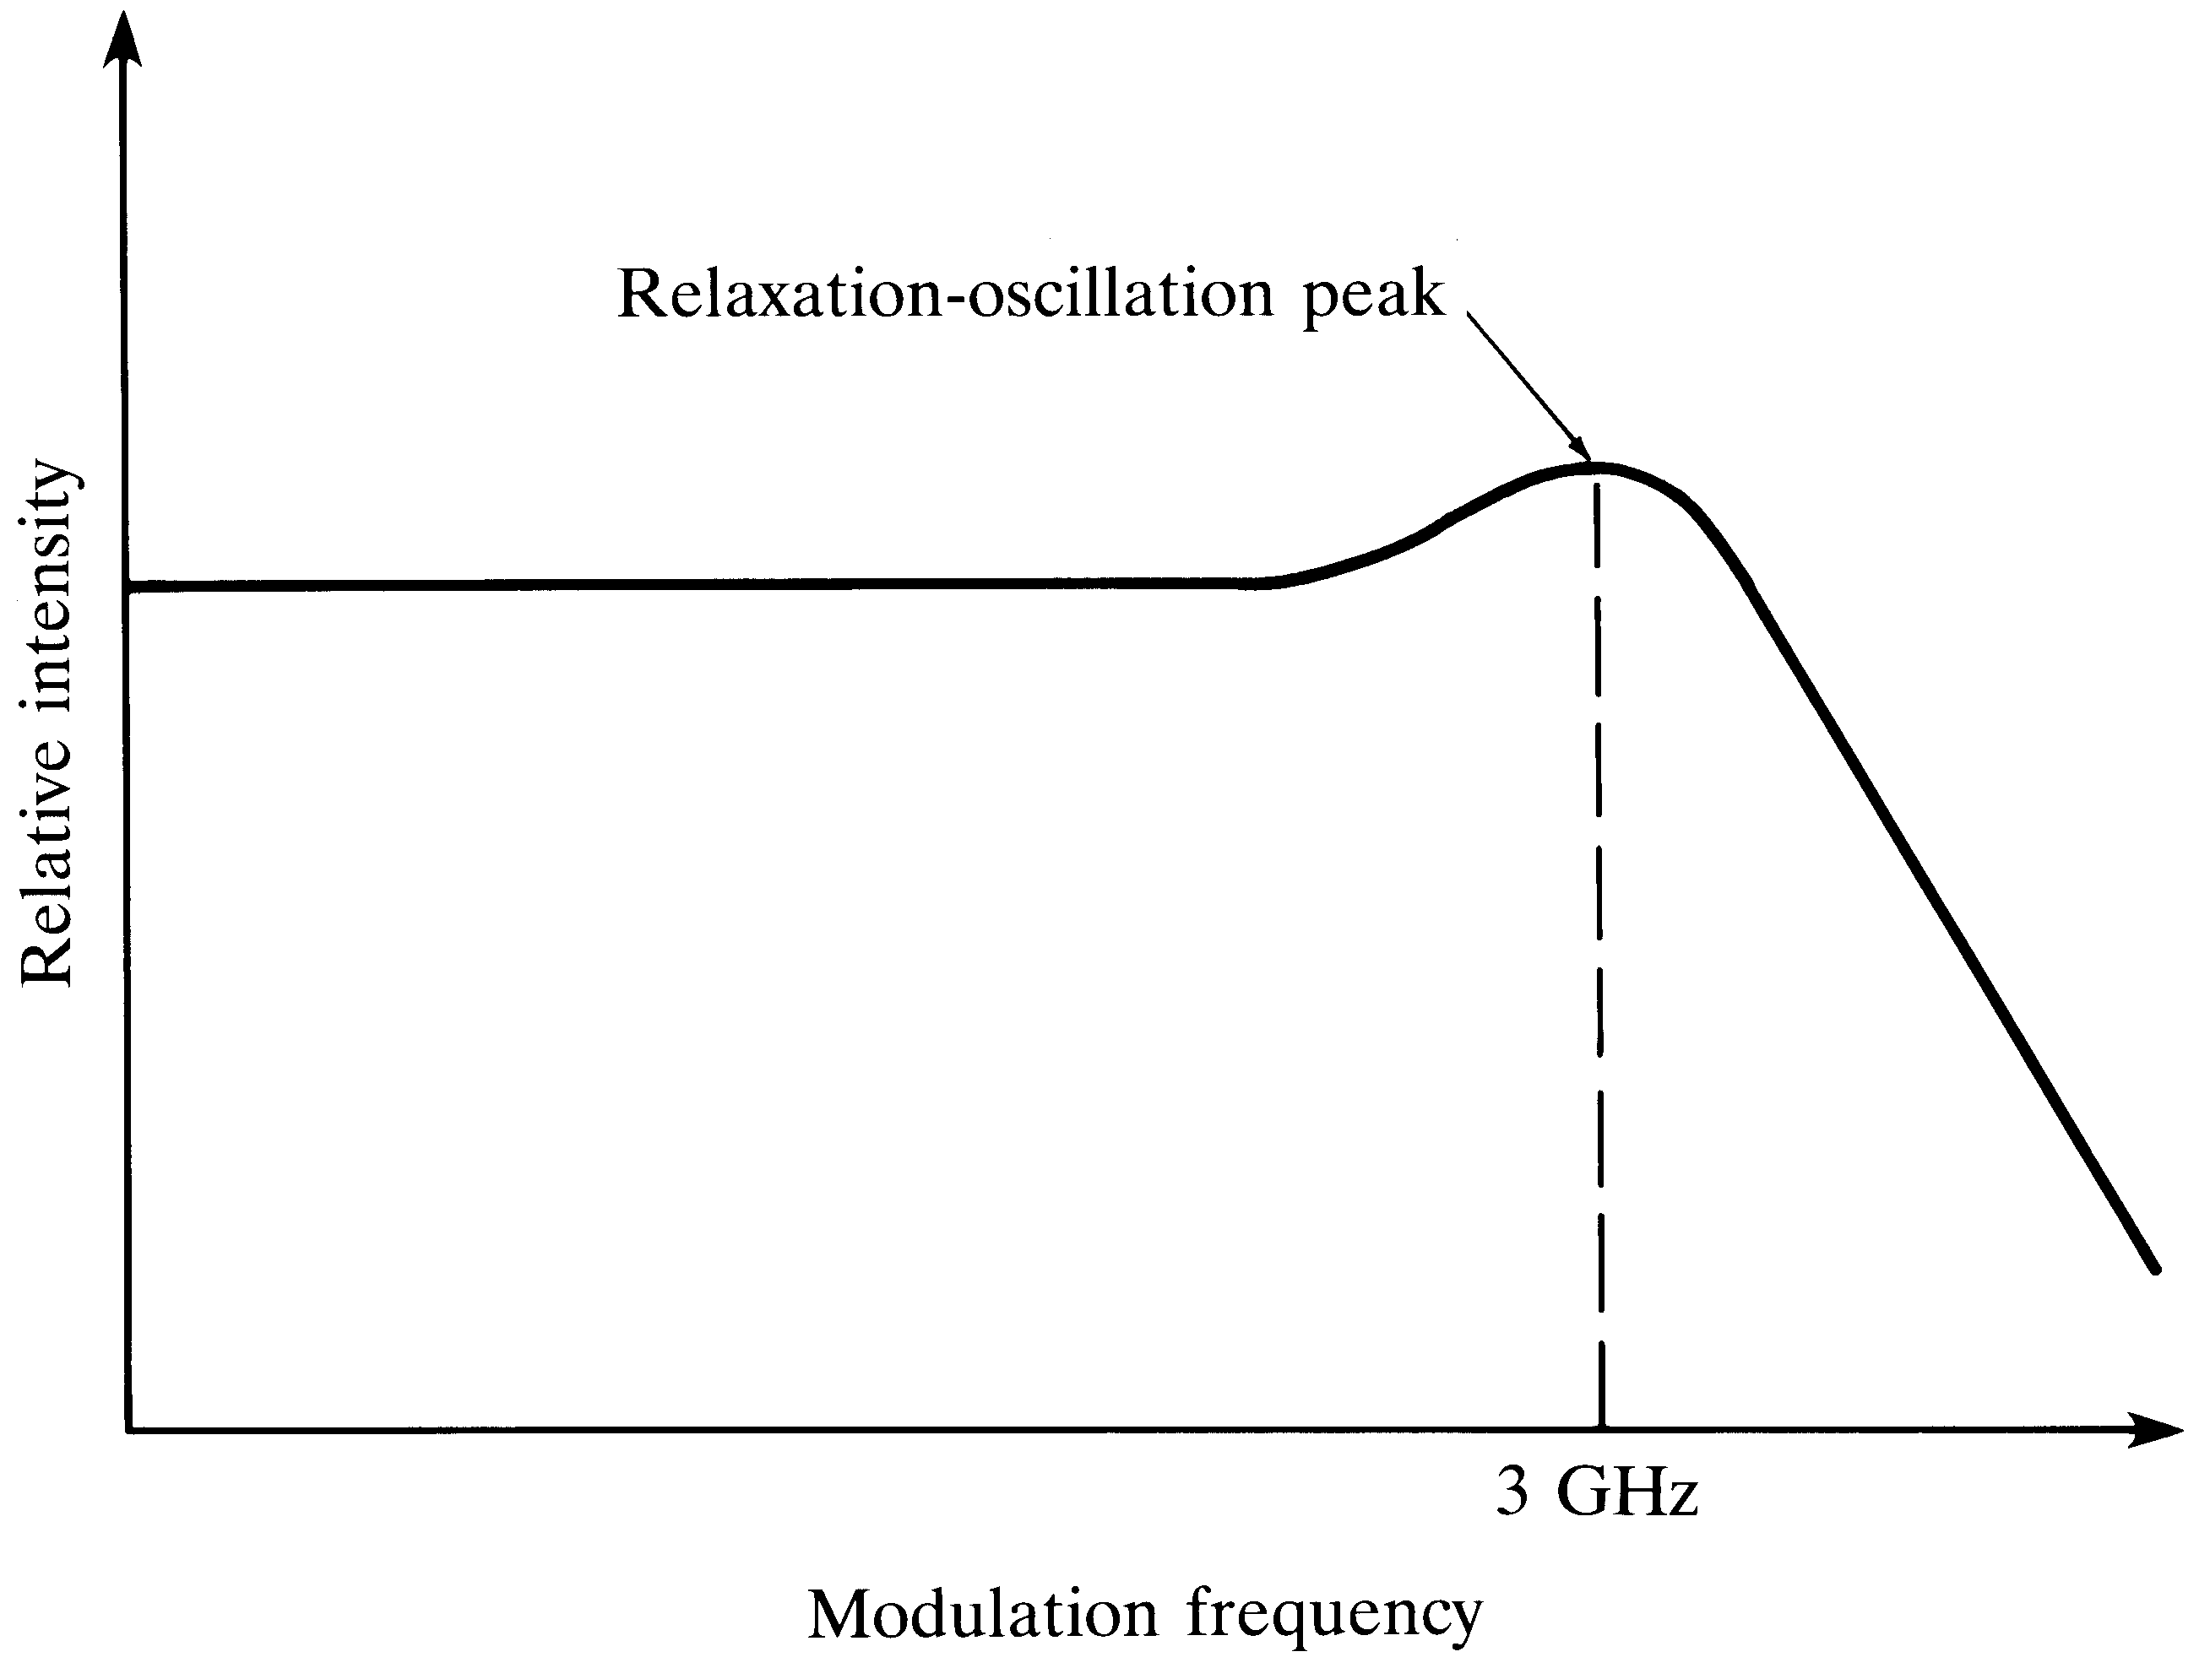
Frequency Response of a Laser
Resonance Frequency
(f_{r}) limits the highest possible modulation frequency
Useful Region

Slide 69
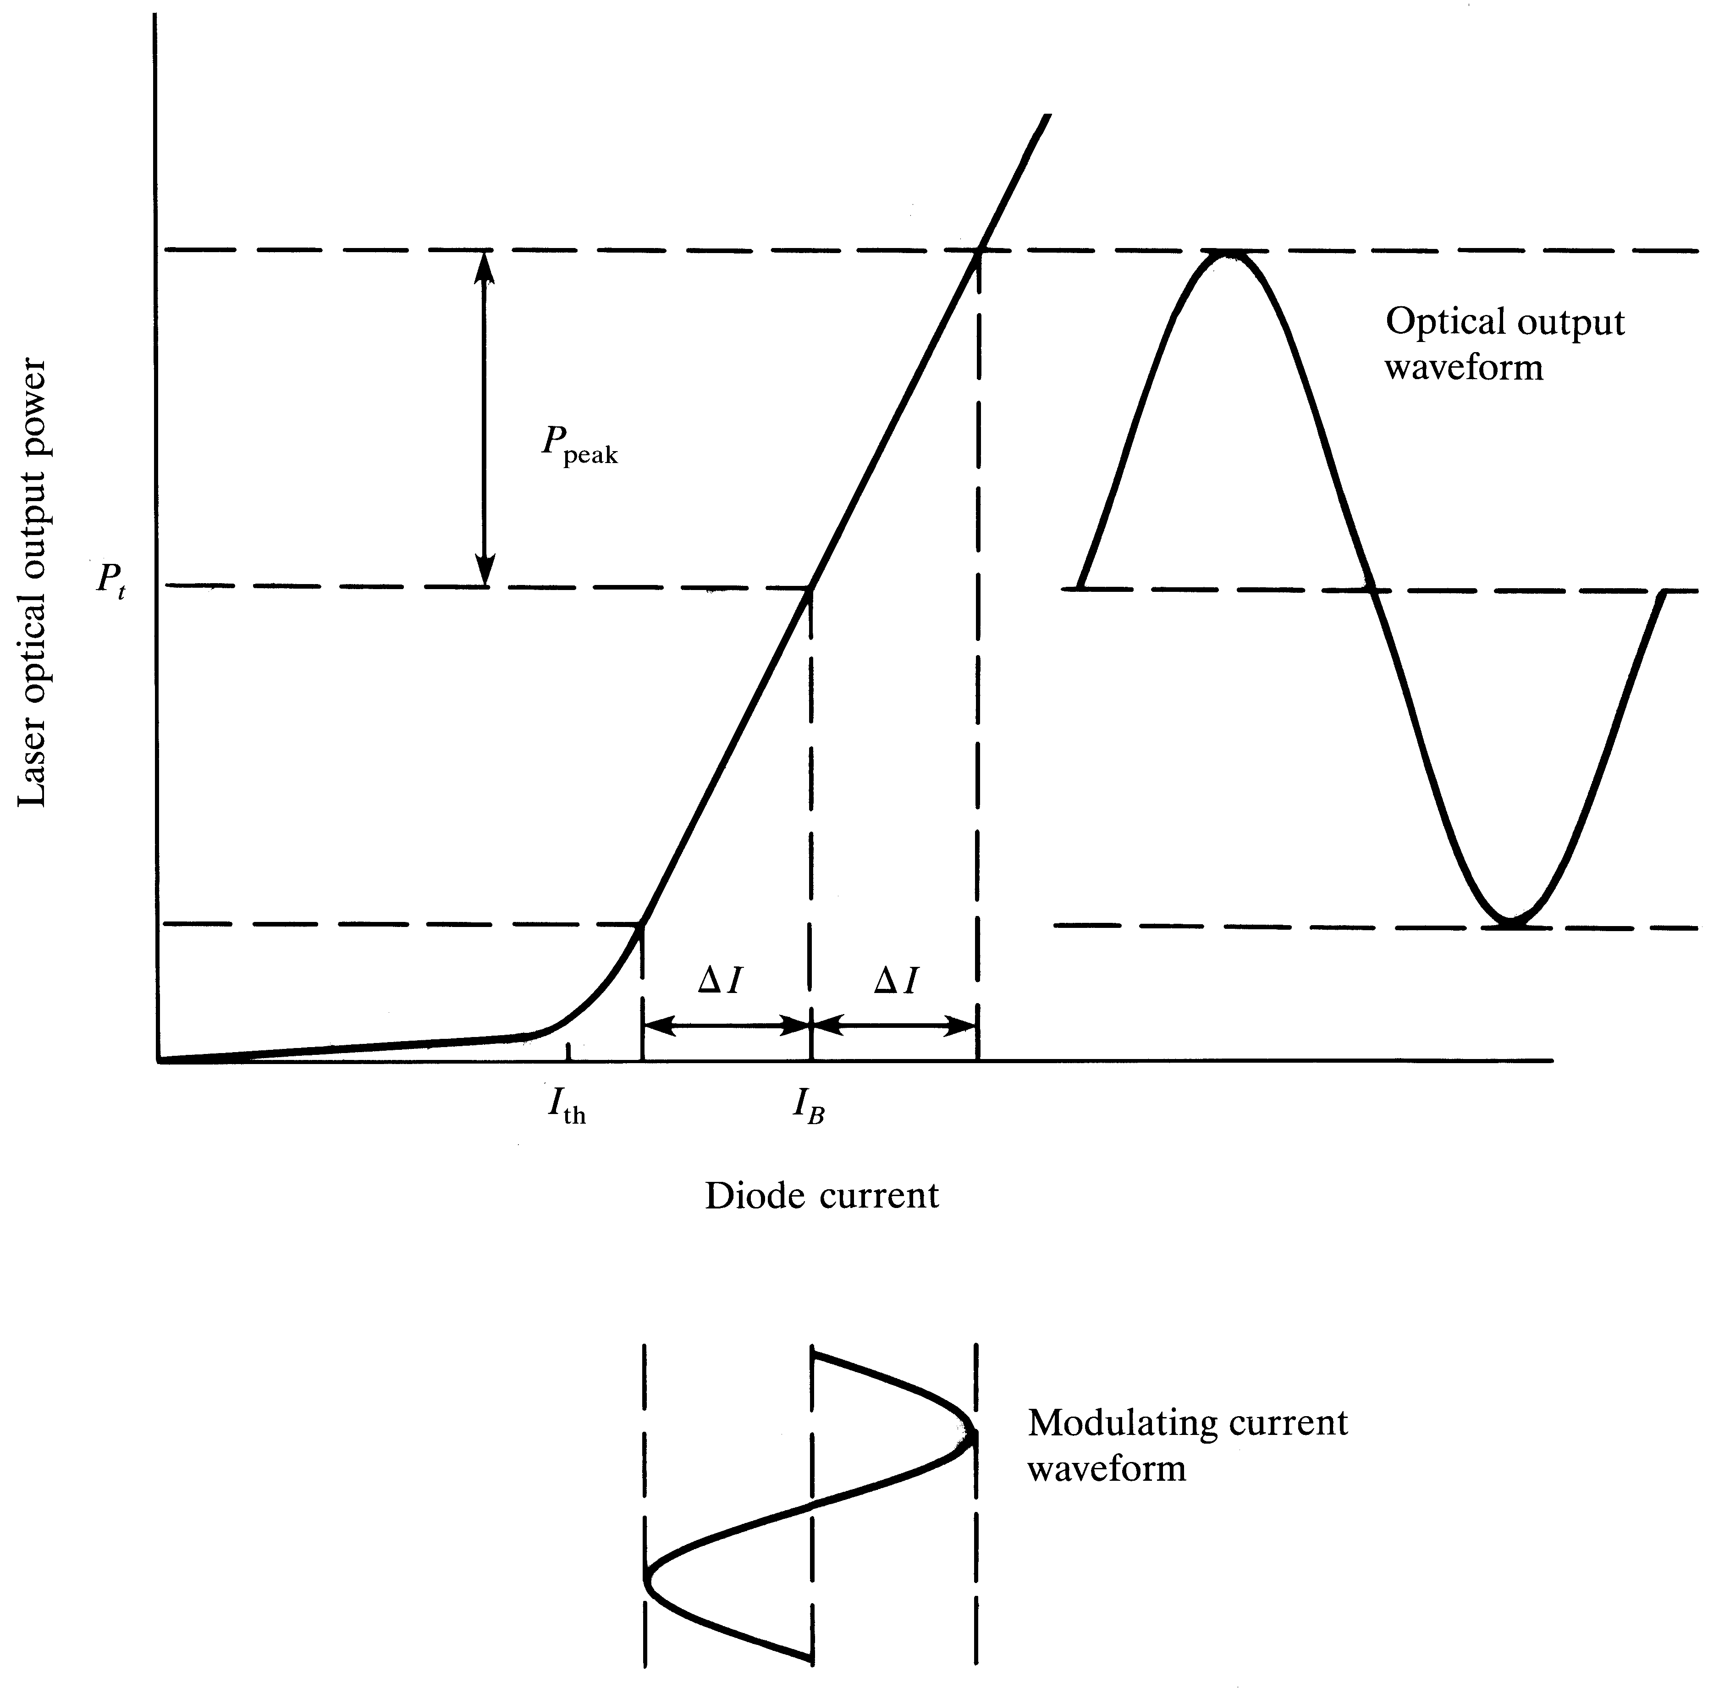
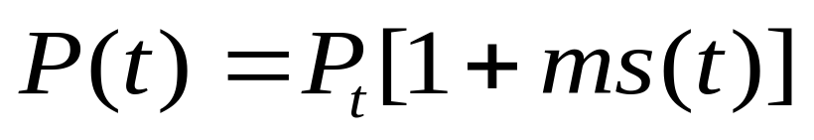
Laser Analog
Modulation
P(t)
Here s(t) is the modulating signal,
P(t): output optical power
P_{t}: mean value
S(t)

Slide 70
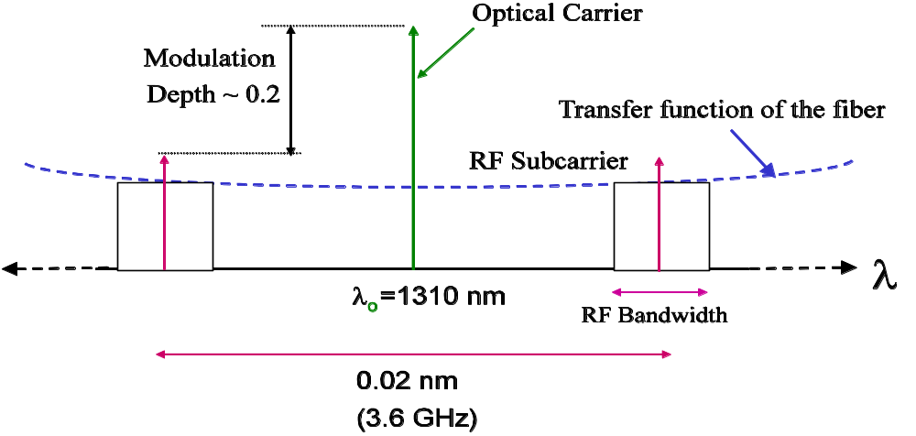
The modulated spectrum
Twice the RF frequency
Two sidebands each separated by modulating frequency

Slide 71
Limitations of Direct Modulation
Turn on delay and resonance frequency are the two major factors that limit the speed of digital laser modulation
Saturation and clipping introduces nonlinear distortion with analog modulation (especially in multi carrier systems)
Nonlinear distortions introduce second and third order intermodulation products
Chirp: Laser output wavelength drift with modulating current is also another issue

Slide 72
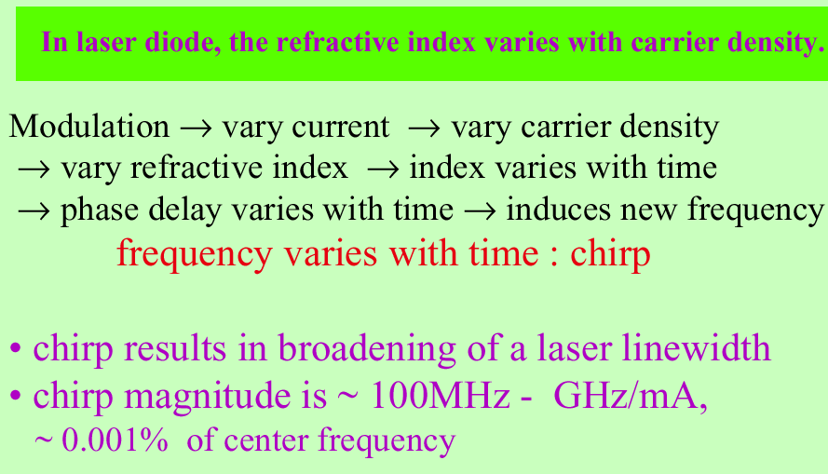
Chirp

Slide 73
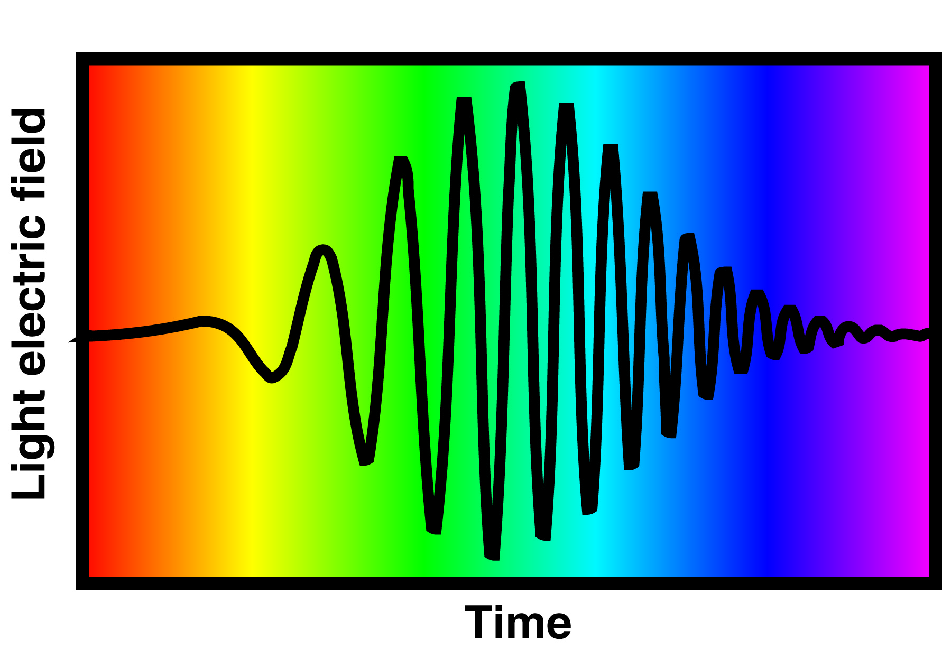
The Chirped Pulse
A pulse can have a frequency that varies in time.
This pulse increases its frequency linearly in time (from red to blue).
In analogy to bird sounds, this pulse is called a "chirped" pulse.

Slide 74
Temperature dependency of the laser is another issue

Slide 75
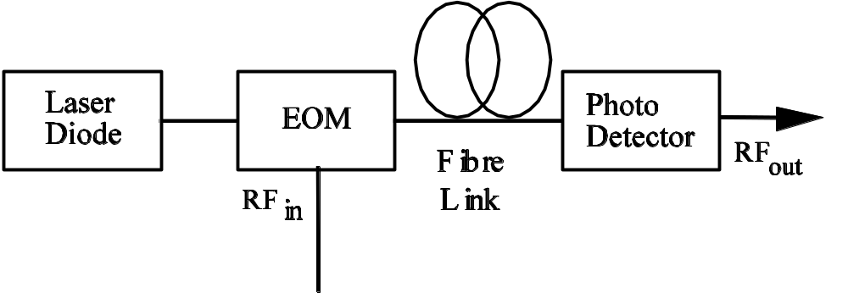
External Optical Modulation
Modulation and light generation are separated
Offers much wider bandwidth → up to 60 GHz
More expensive and complex
Used in high end systems

Slide 76
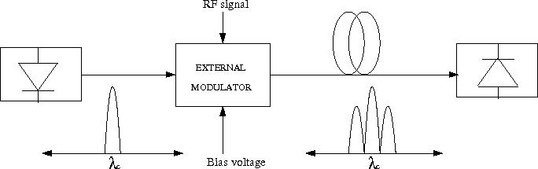
External Modulated Spectrum
Typical spectrum is double side band
However, single side band is possible which is useful at extreme RF frequencies

Slide 77
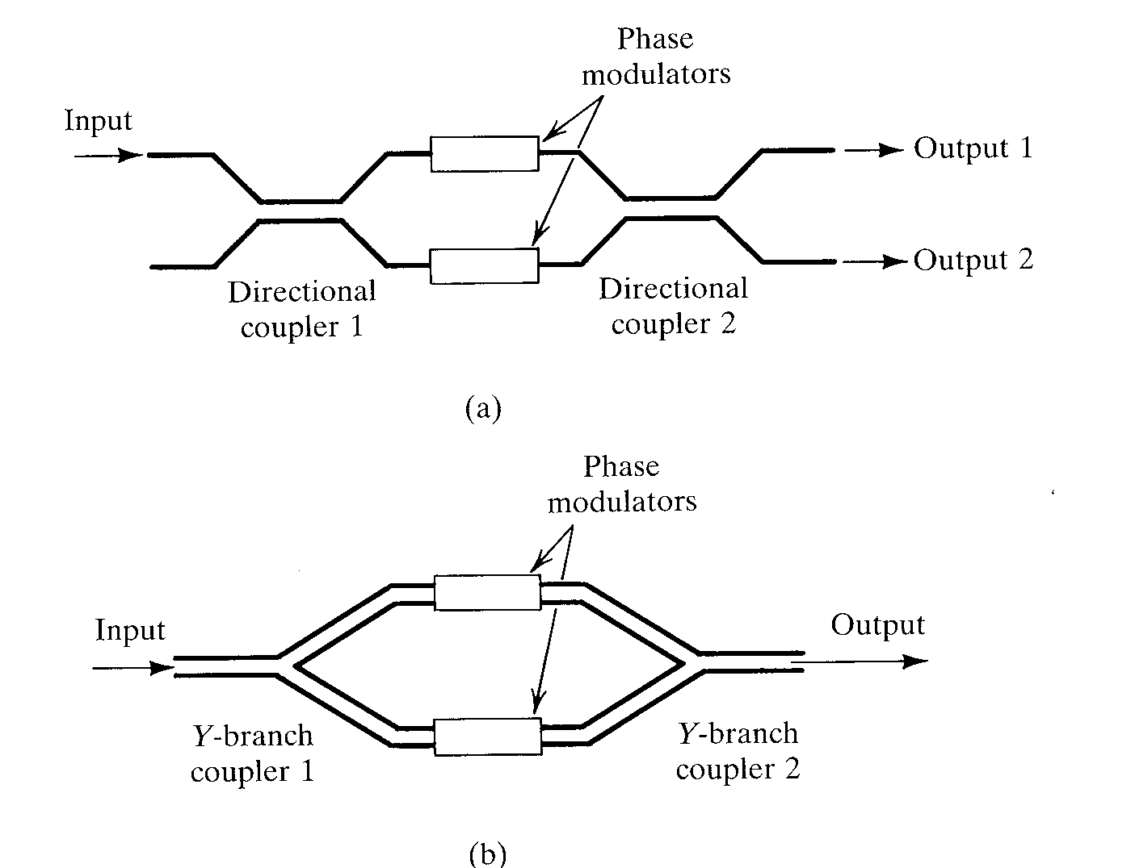
Mach-Zehnder Interferometers

Slide 78
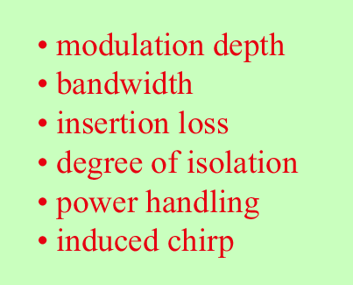
Parameters to characterize performance of optical modulation

Slide 79
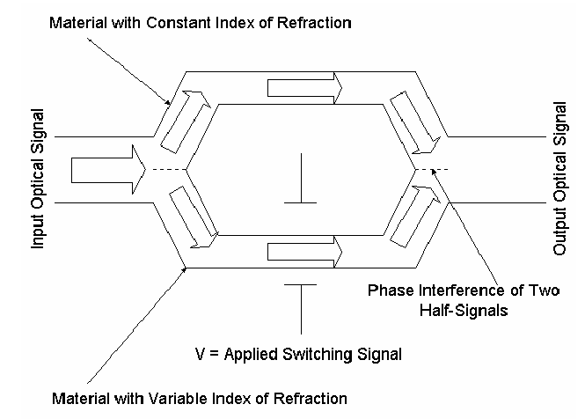
Mach- Zehnder modulator

Slide 80
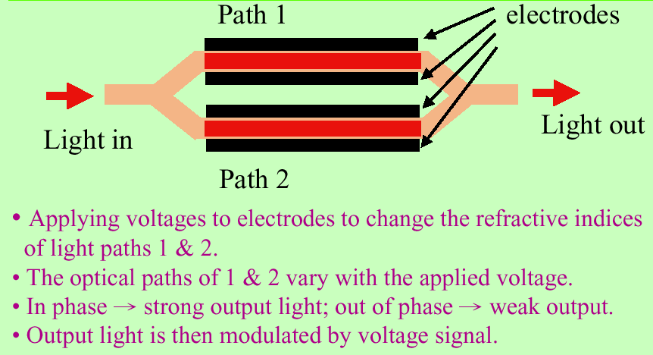
Mach- Zehnder modulator

Slide 81
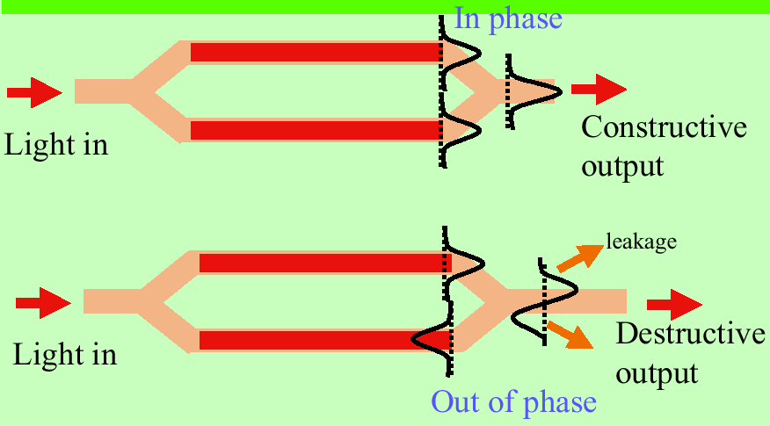

Slide 82
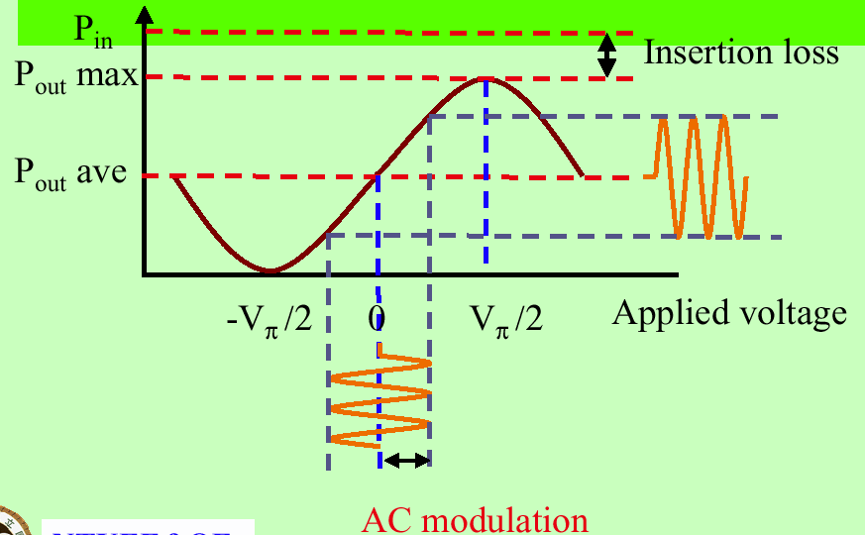

Slide 83

Characteristics of Mach- Zehnder modulator

Slide 84

Electro- absorption (EA) modulator

Slide 85

Integration of EA modulator with LD

Slide 86

Characteristics of EA modulator

Slide 87

Mach-Zehnder Principle

Slide 88

Distributed Feedback Laser
(Single Mode Laser)
The optical feedback is provided by fiber Bragg Gratings
→ Only one wavelength get positive feedback

Slide 89

Photo Detection Principles
Bias voltage usually needed to fully deplete the intrinsic “I” region for high speed operation
Device Layer Structure
Band Diagram
showing carrier
movement in E-field
Light intensity as a
function of distance below
the surface
Carriers absorbed here must diffuse to the intrinsic layer before they recombine if they are to contribute to the photocurrent. Slow diffusion can lead to slow “tails” in the temporal response.
(Hitachi Opto Data Book)

Slide 90

Current-Voltage Characteristic for a Photodiode

Slide 91

Characteristics of Photodetectors
• Internal
Quantum Efficiency
•External
Quantum efficiency
• Responsivity
•Photocurrent
Fraction Transmitted
into Detector
Incident Photon Flux
(#/sec)
Fraction absorbed in
detection region

Slide 92

Responsivity
Output current per unit incident light power; typically 0.5 A/W

Slide 93

Photodiode Responsivity

Slide 94

Detector Sensitivity vs. Wavelength
Absorption coefficient vs. Wavelength
for several materials
(Bowers 1987)
Photodiode Responsivity vs. Wavelength
for various materials
(Albrecht et al 1986)

Slide 95

PIN photodiodes
Energy-band diagram
p-n junction
Electrical Circuit

Slide 96

Basic PIN Photodiode Structure
Rear Illuminated Photodiode
Front Illuminated Photodiode

Slide 97

PIN Diode Structures
Diffused Type
(Makiuchi et al. 1990)
Diffused Type
(Dupis et al 1986)
Etched Mesa Structure
(Wey et al. 1991)
Diffused structures tend to have lower dark current than mesa etched structures although they are
more difficult to integrate with electronic devices because an additional high temperature processing step is required.

Slide 98
Avalanche Photodiodes (APDs)
High resistivity p-doped layer increases electric field across absorbing region
High-energy electron-hole pairs ionize other sites to multiply the current
Leads to greater sensitivity

Slide 99



APD Detectors
Signal Current
APD Structure and field distribution (Albrecht 1986)

Slide 100


APDs Continued

Slide 101
Detector Equivalent Circuits
R_{d}
I_{ph}
I_{d}
C_{d}
PIN
R_{d}
I_{ph}
I_{d}
I_{n}
C_{d}
APD
I_{ph}=Photocurrent generated by detector
C_{d}=Detector Capacitance
I_{d}=Dark Current
I_{n}=Multiplied noise current in APD
R_{d}=Bulk and contact resistance

Slide 102
MSM Detectors
Light
Schottky barrier
gate metal
Simple to fabricate
Quantum efficiency: Medium
  Problem: Shadowing of absorption
  region by contacts
Capacitance: Low
Bandwidth: High
  Can be increased by thinning absorption layer and
  backing with a non absorbing material. Electrodes
  must be moved closer to reduce transit time.
Compatible with standard electronic processes
  GaAs FETS and HEMTs
  InGaAs/InAlAs/InP HEMTs
Semi insulating
GaAs
Simplest Version
To increase speed
decrease electrode spacing
and absorption depth
Absorption
layer
E Field
penetrates for
~ electrode spacing
into material
Non absorbing substrate

Slide 103

Waveguide Photodetectors
Waveguide detectors are suited for very high bandwidth applications
Overcomes low absorption limitations
Eliminates carrier generation in field free regions
Decouples transit time from quantum efficiency
Low capacitance
More difficult optical coupling

Slide 104
Carrier transit time
Transit time is a function of depletion width and carrier drift velocity
t_{d}= w/v_{d}

Slide 105

Detector Capacitance
x_{p}
x_{n}
Capacitance must be minimized for high sensitivity (low noise) and for high speed operation
Minimize by using the smallest light collecting area consistent with efficient collection of the incident light
Minimize by putting low doped “I” region between the P and N doped regions to increase W, the depletion width
W can be increased until field required to fully deplete causes excessive dark current, or carrier transit time begins to limit speed.
P
N
p-n junction

Slide 106
Bandwidth limit
C=ε₀K A/w
where K is dielectric constant, A is area, w is depletion width, and ε₀ is the permittivity of free space (8.85 pF/m)
B = 1/2πRC

Slide 107



PIN Bandwidth and Efficiency Tradeoff
Transit time
τ=W/v_{sat}
v_{sat}=saturation velocity=2x10⁷ cm/s
R-C Limitation
Responsivity
Diffusion
τ=4 ns/µm (slow)

Slide 108
Dark Current
Surface Leakage
Bulk Leakage
Surface Leakage
Ohmic Conduction
Generation-recombination
via surface states
Bulk Leakage
Diffusion
Generation-Recombination
Tunneling
Usually not a significant noise source at high bandwidths
for PIN Structures
High dark current can indicate poor potential reliability
In APDs its multiplication can be significant

Slide 109


Signal to Noise Ratio
i_{p}= average signal photocurrent level
based on modulation index m where

Slide 110

Optimum value of M
where F(M) = M^{x} and m=1

Slide 111

Noise Equivalent Power (NEP)
Signal power where S/N=1
Units are W/Hz^{1/2}

Slide 112

Typical Characteristics of P-I-N and Avalanche photodiodes

Slide 113
Comparisons
PIN gives higher bandwidth and bit rate
APD gives higher sensitivity
Si works only up to 1100 nm; InGaAs up to 1700, Ge up to 1800
InGaAs has higher η for PIN, but Ge has higher M for APD
InGaAs has lower dark current

